Slide 1
一些天体对宇宙线遮挡作用的估计
李军
2020/12/29

Slide 2
提纲
定义天体对于宇宙线的遮挡率
用1999/11/8 00:00 +240进行程序验证和大致的估计
用2020/1/1 00:00+1825进行进一步的分析

Slide 3
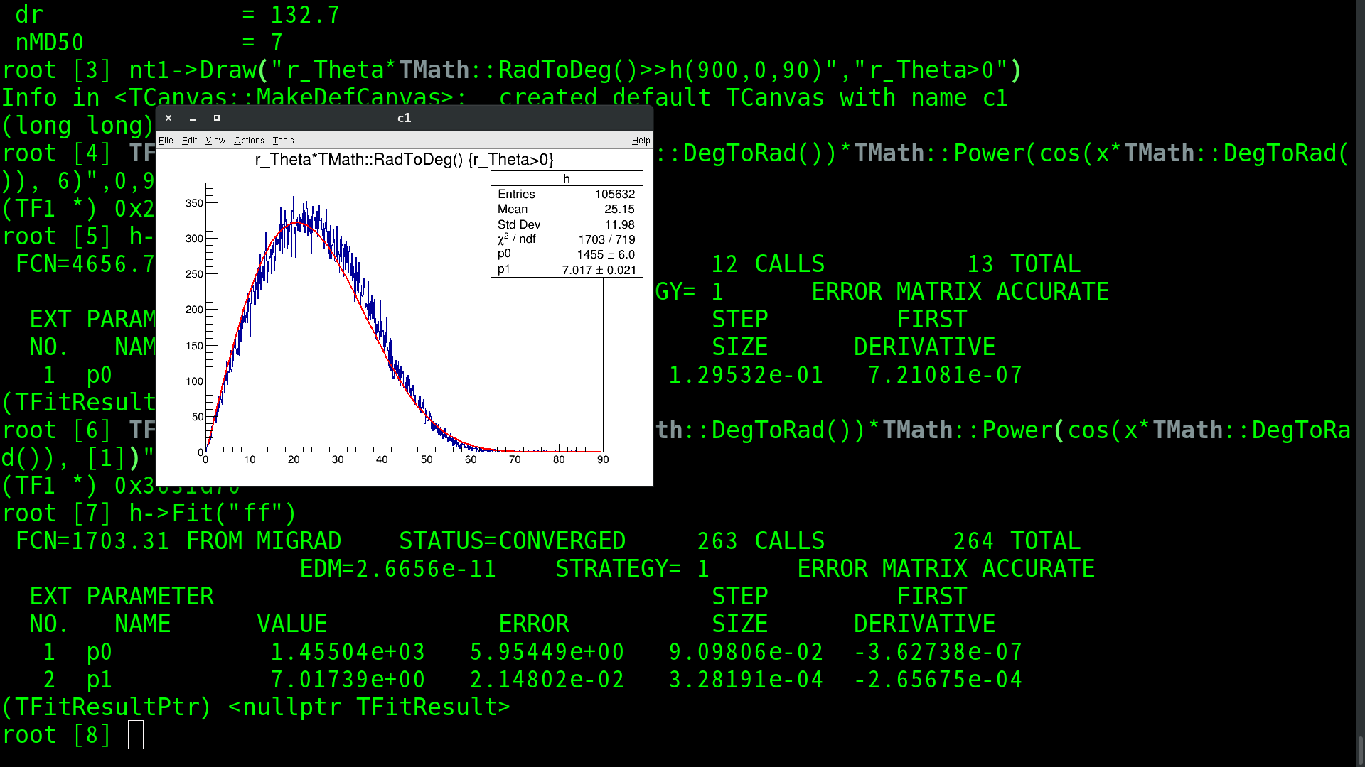
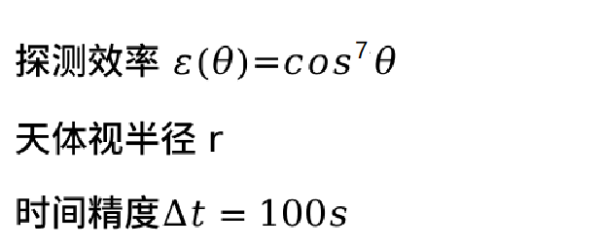
天体对宇宙线的遮挡
定义：
$f=\sum{∆tr^{2}ε\left(θ\right)}$
事例数
Zenith

Slide 4
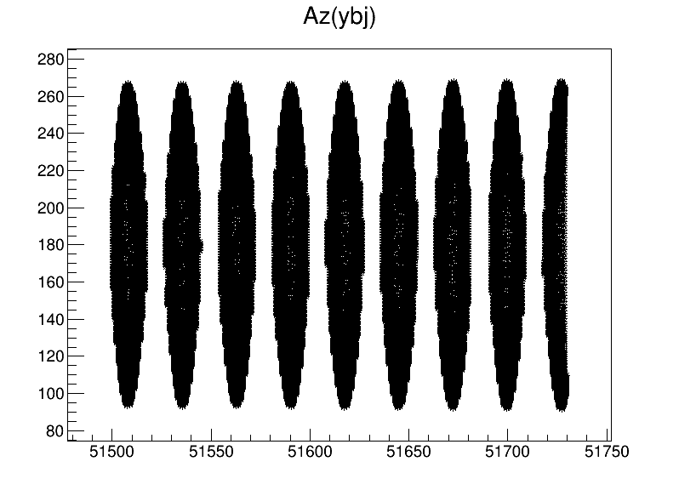
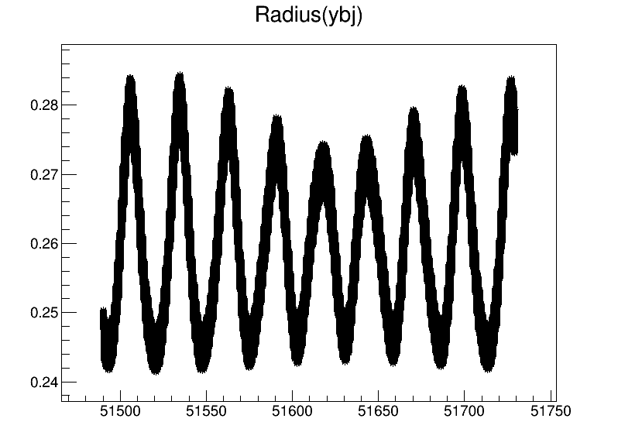
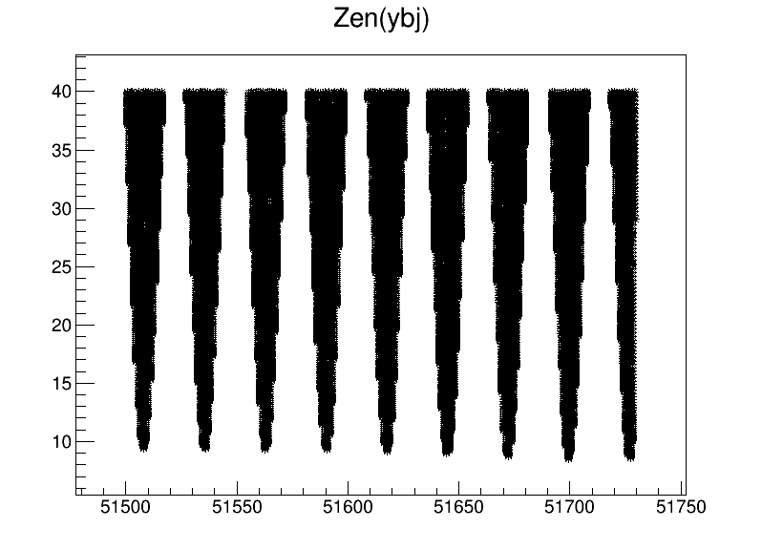
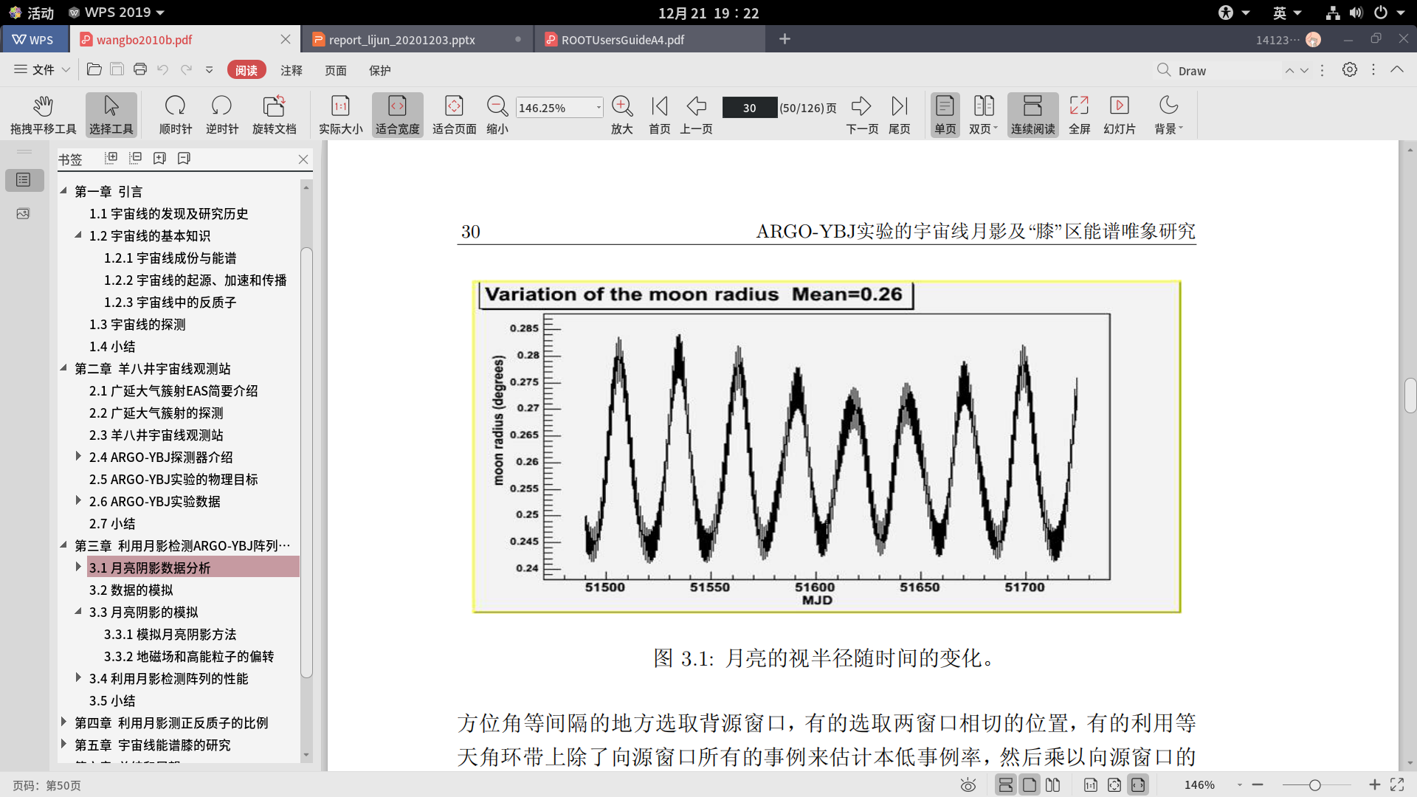
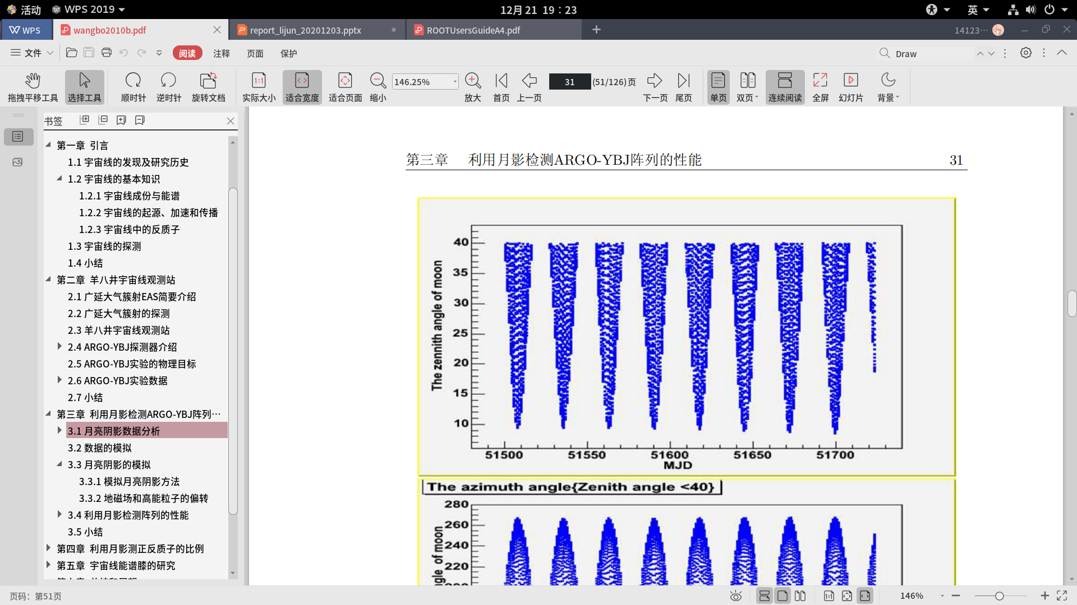
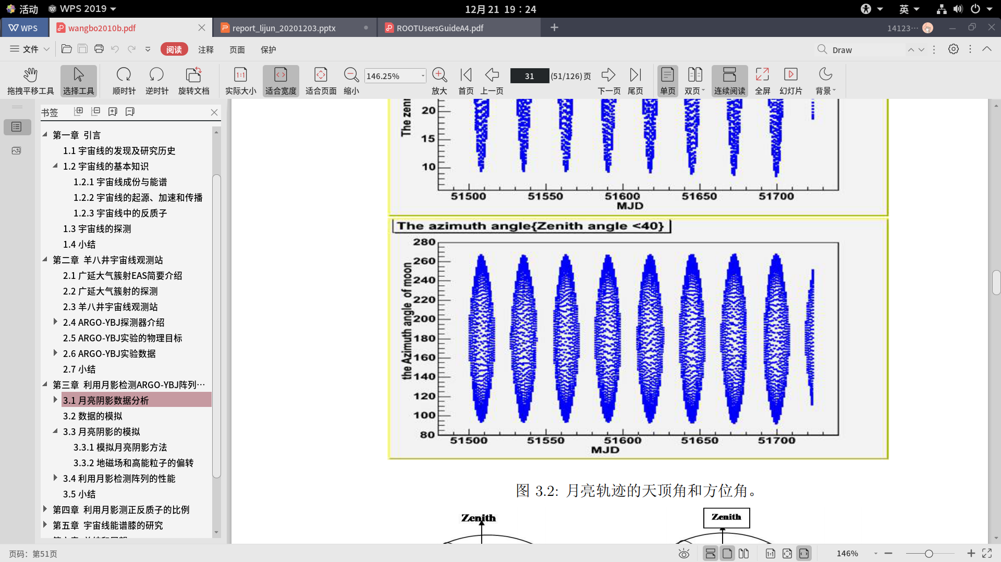
月亮的视半径、天顶角和方位角分布Zenith angle < 40

Slide 5
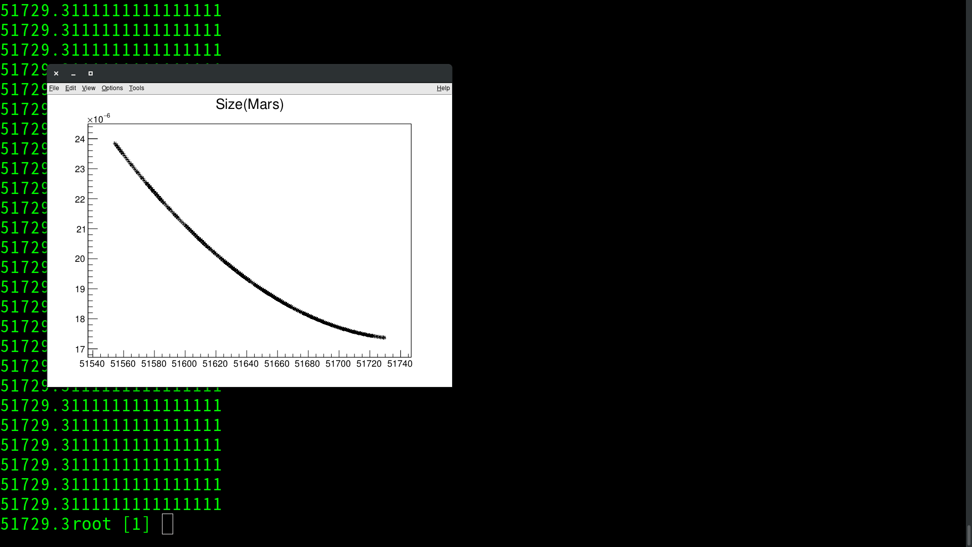

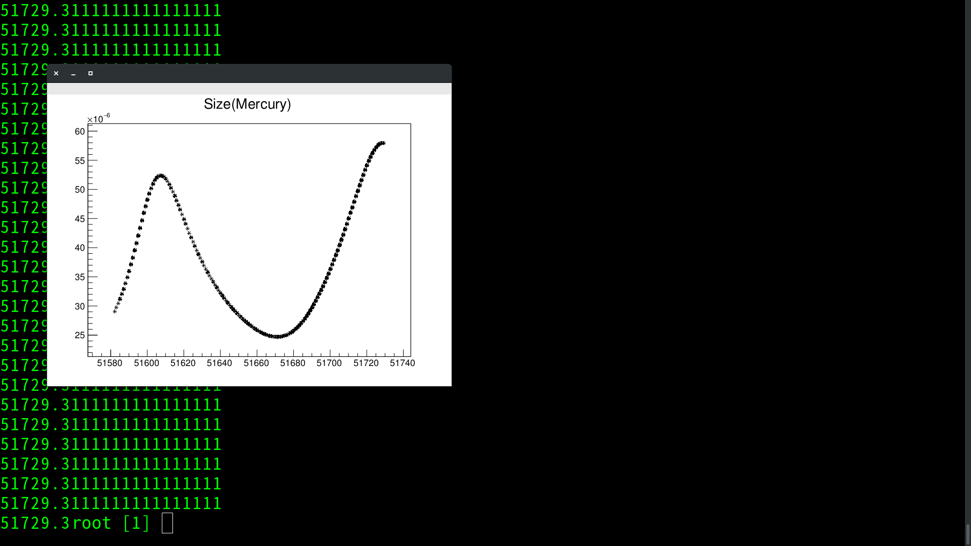
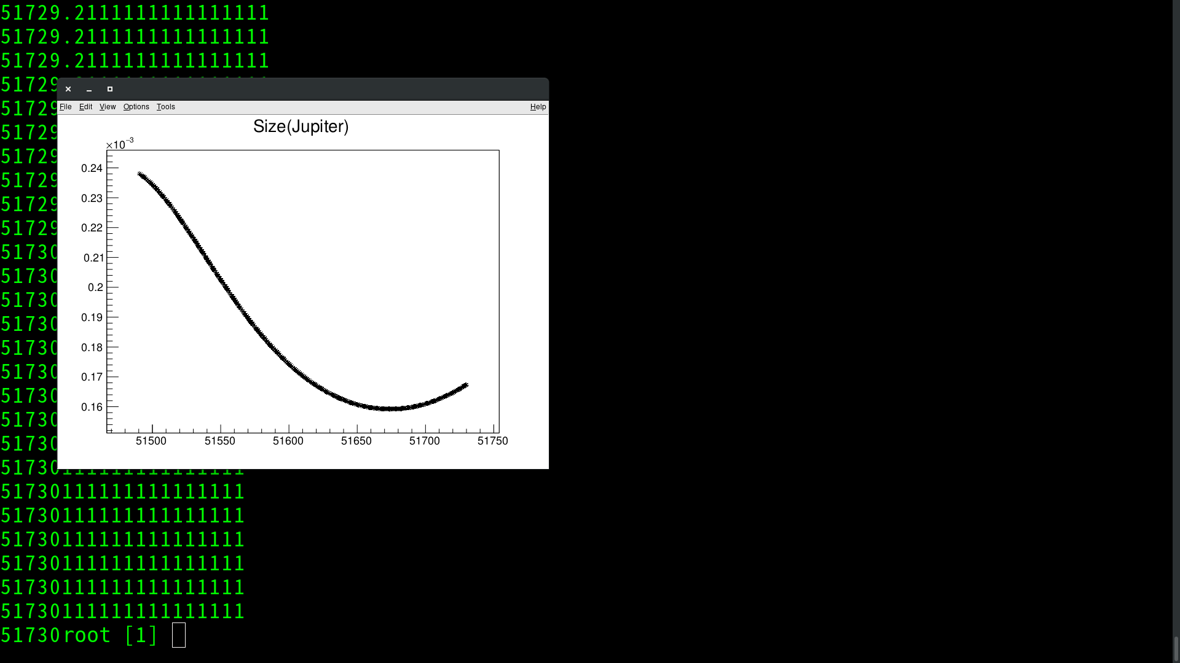

大行星大小分布(横轴：mjd 纵轴：size ) 1999/11/8 00:00 +240

Slide 6
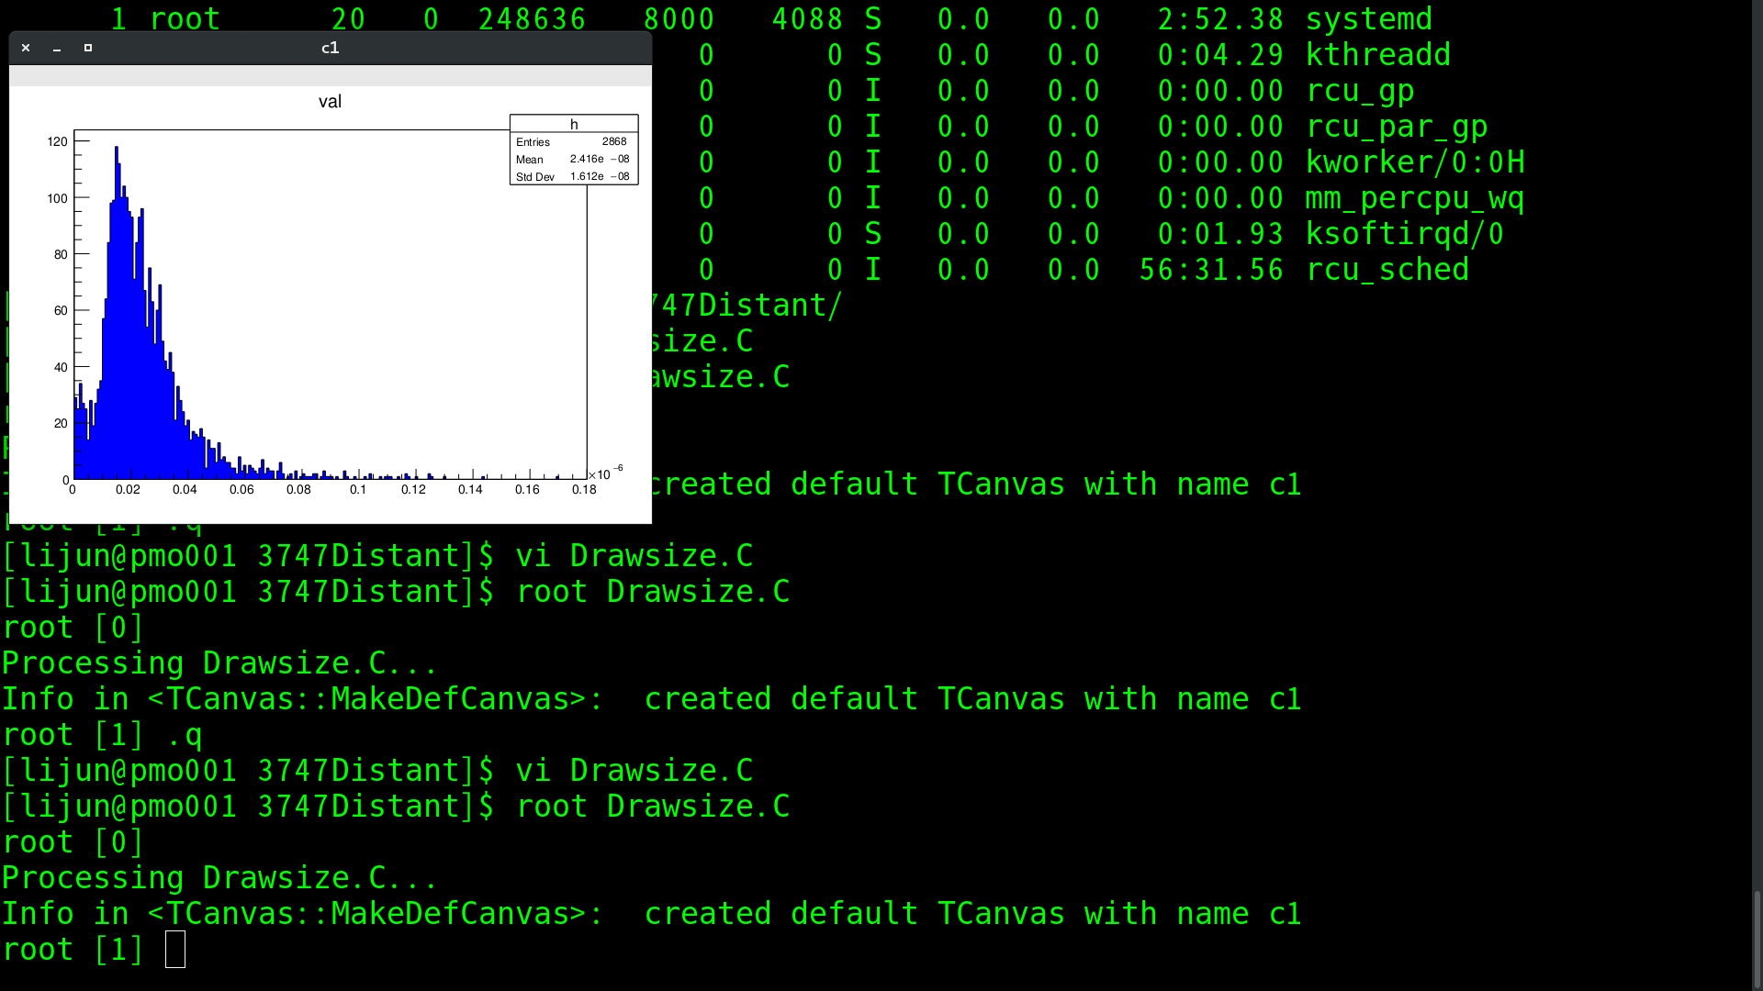
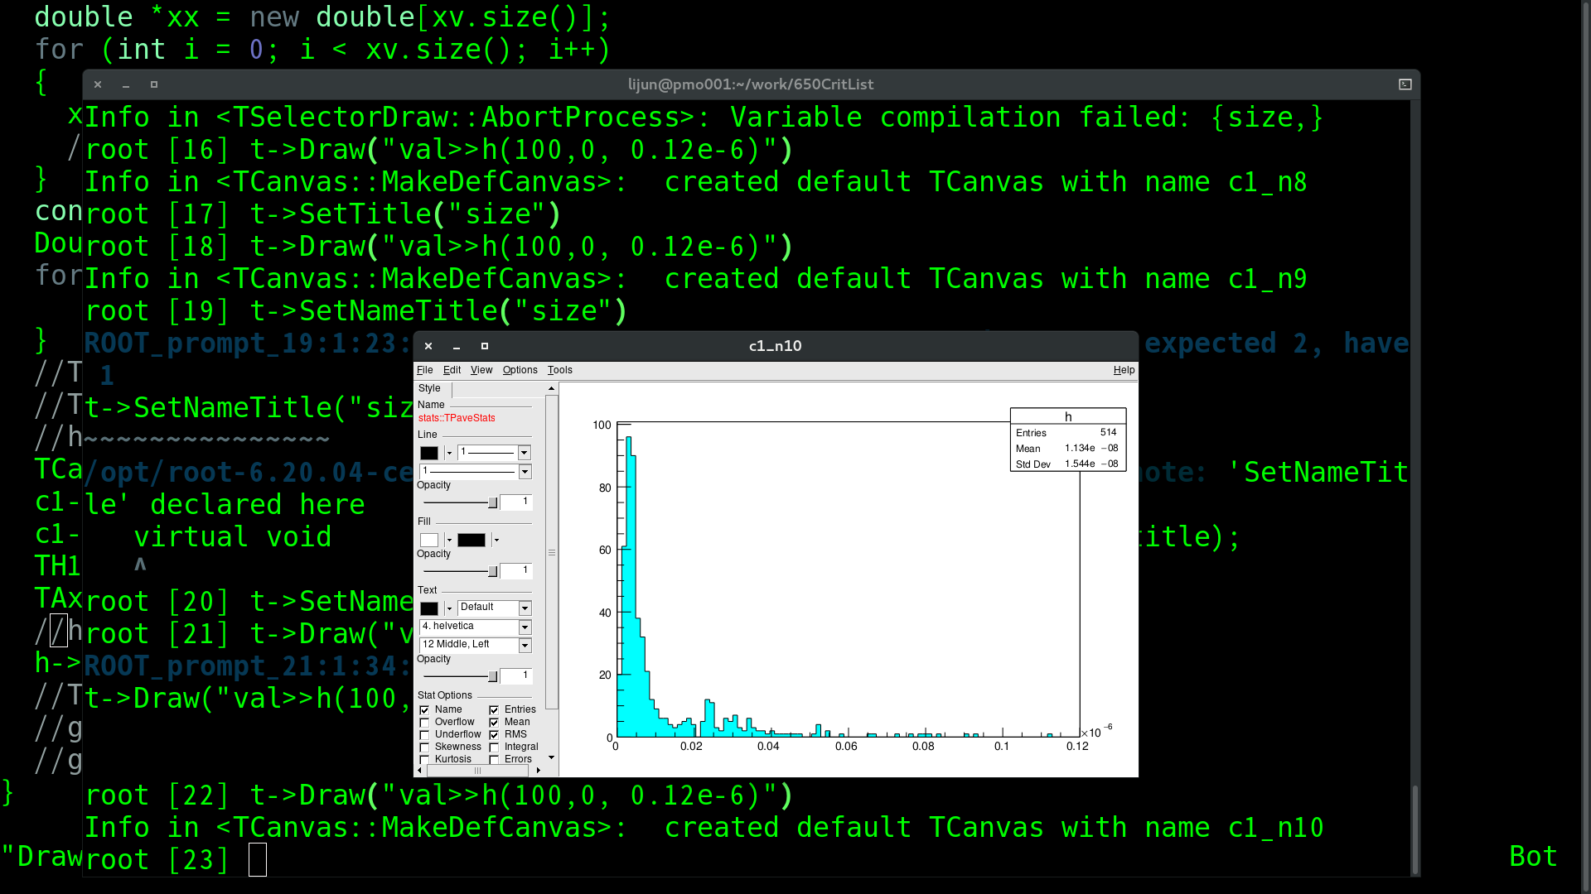
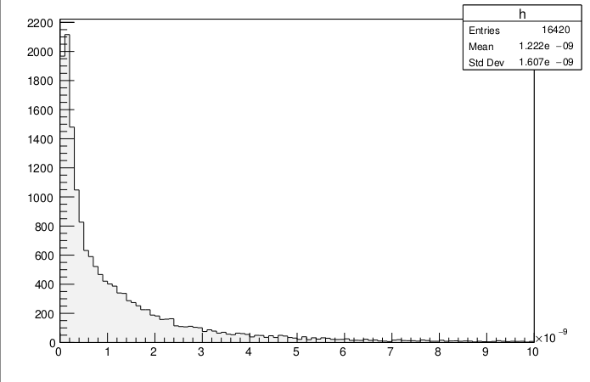
Size distributions of minor planets 1999/11/8 00:00 +240
quantity
size
quantity
Distant minor planets
quantity
size
Critical-list numbered minor planets
size
Unusual minor planets

Slide 7
各类天体遮挡率占月球比例 1999/11/8 00:00 +240
 | f | Rate
Critical-list numbered minor planets(650) | 8.829751182200507e-08 | 3.2282021887719847e-09
Distant minor planets(3747) | 5.305722291223427e-06 | 1.939799203863323e-07
Unusual minor planets(18169) | 0.016616452807548025 | 0.00060751
All minor planets(22166) | 0.01662 | 0.0006077
Mars | 0.000151609868949 | 5.542934344143353e-06
Venus | 0.000823237213982 | 3.009797355799255e-05
Mercury | 0.000405906270226 | 1.4840140825500448e-05
Jupiter | 0.0198143191827 | 0.000724421642634305
Saturn | 0.00472827119363 | 0.00017286801294189946
Comets | 1.406540689944228e-07 | 5.14238469486e-09

Slide 8
预测： mjd: 2020/1/1+1825

Slide 9
大行星2020.1.1 00:00+1825
Moon 207.120064025
Mars 0.00689729430695
Venus 0.0381211310996
Mercury 0.00318853988725
Jupiter 0.0803391225414
Saturn 0.000861242620965
Uranus 0.00145070563109
Neptune 0.000153157267836

Slide 10
小行星2020.1.1 00:00+1825
Moon 207.120064025
Observable critical-list numbered minor planets 6.98885e-07
Observable distant minor planets 3.55714e-05
Observable unusual minor planets 0.0857058

Slide 11
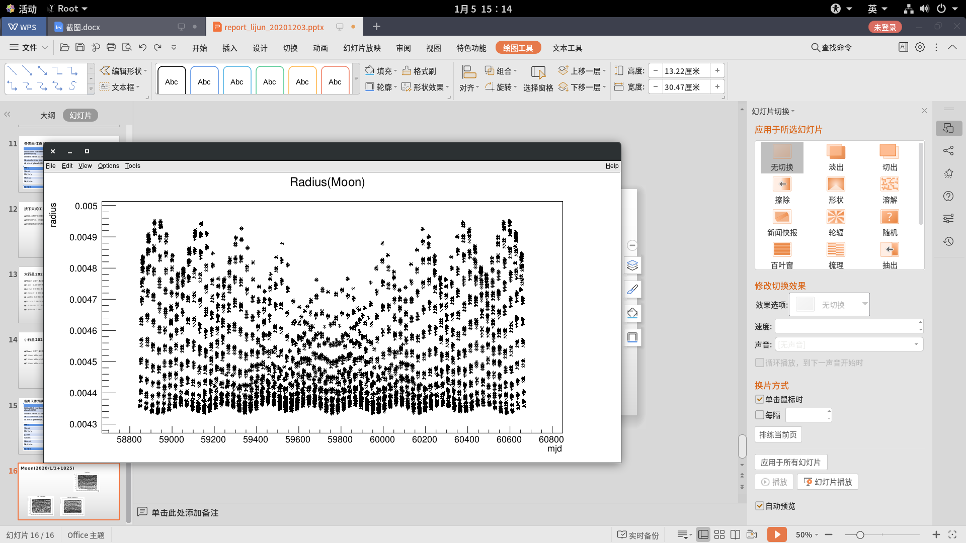
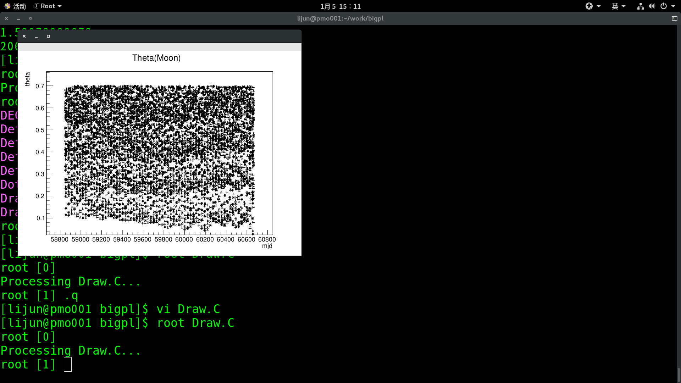
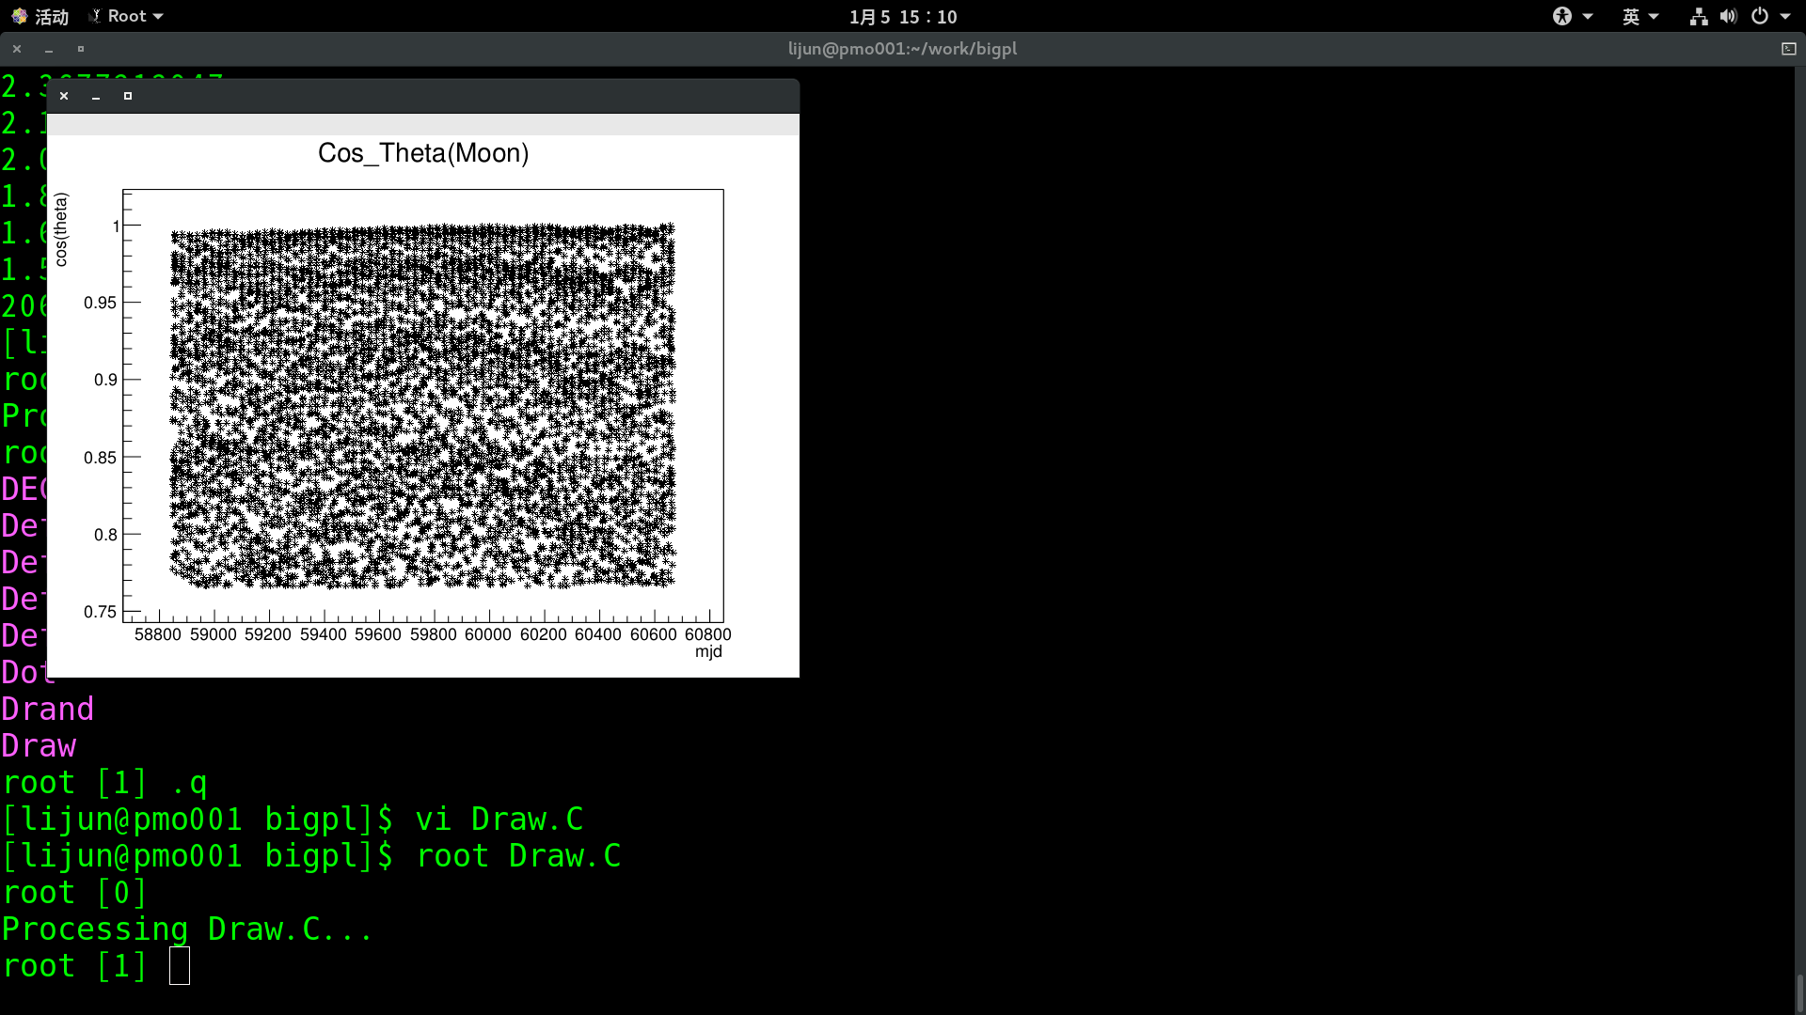
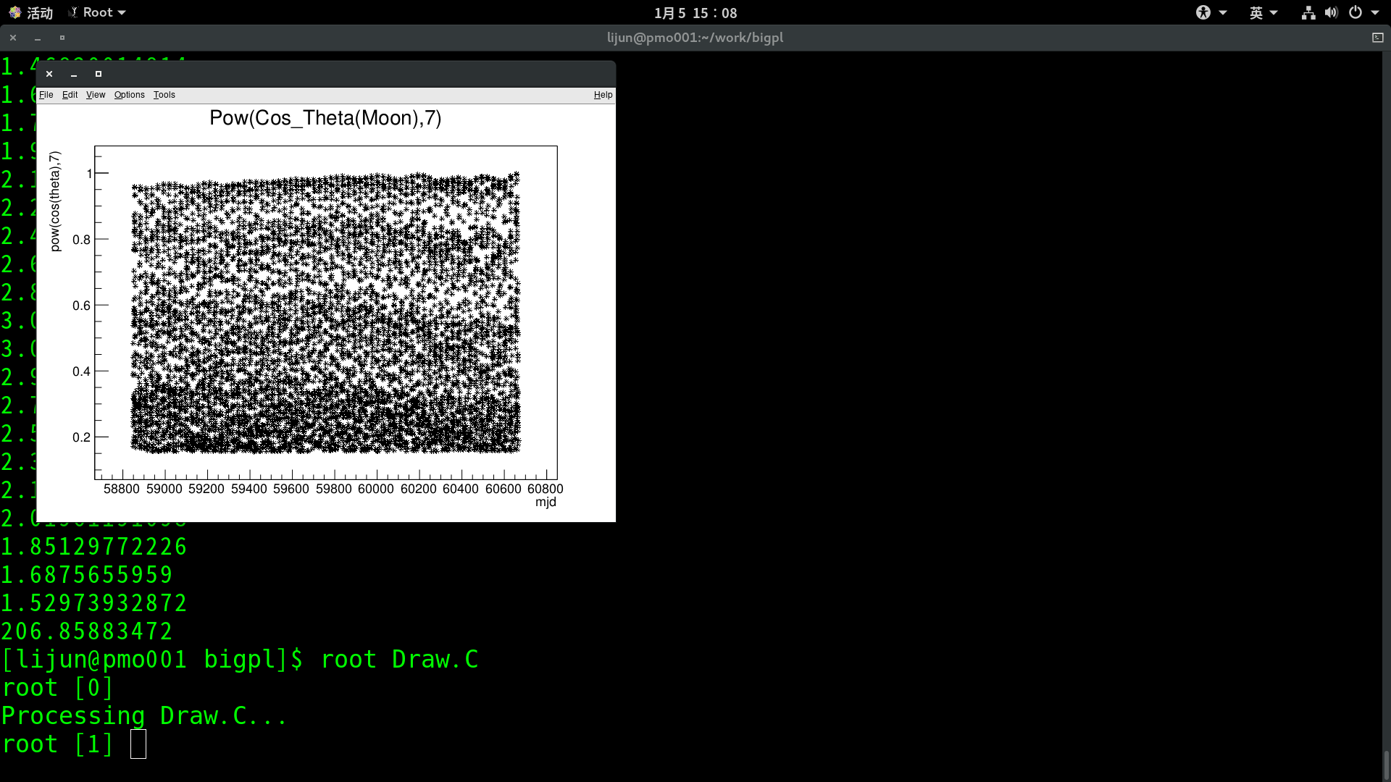
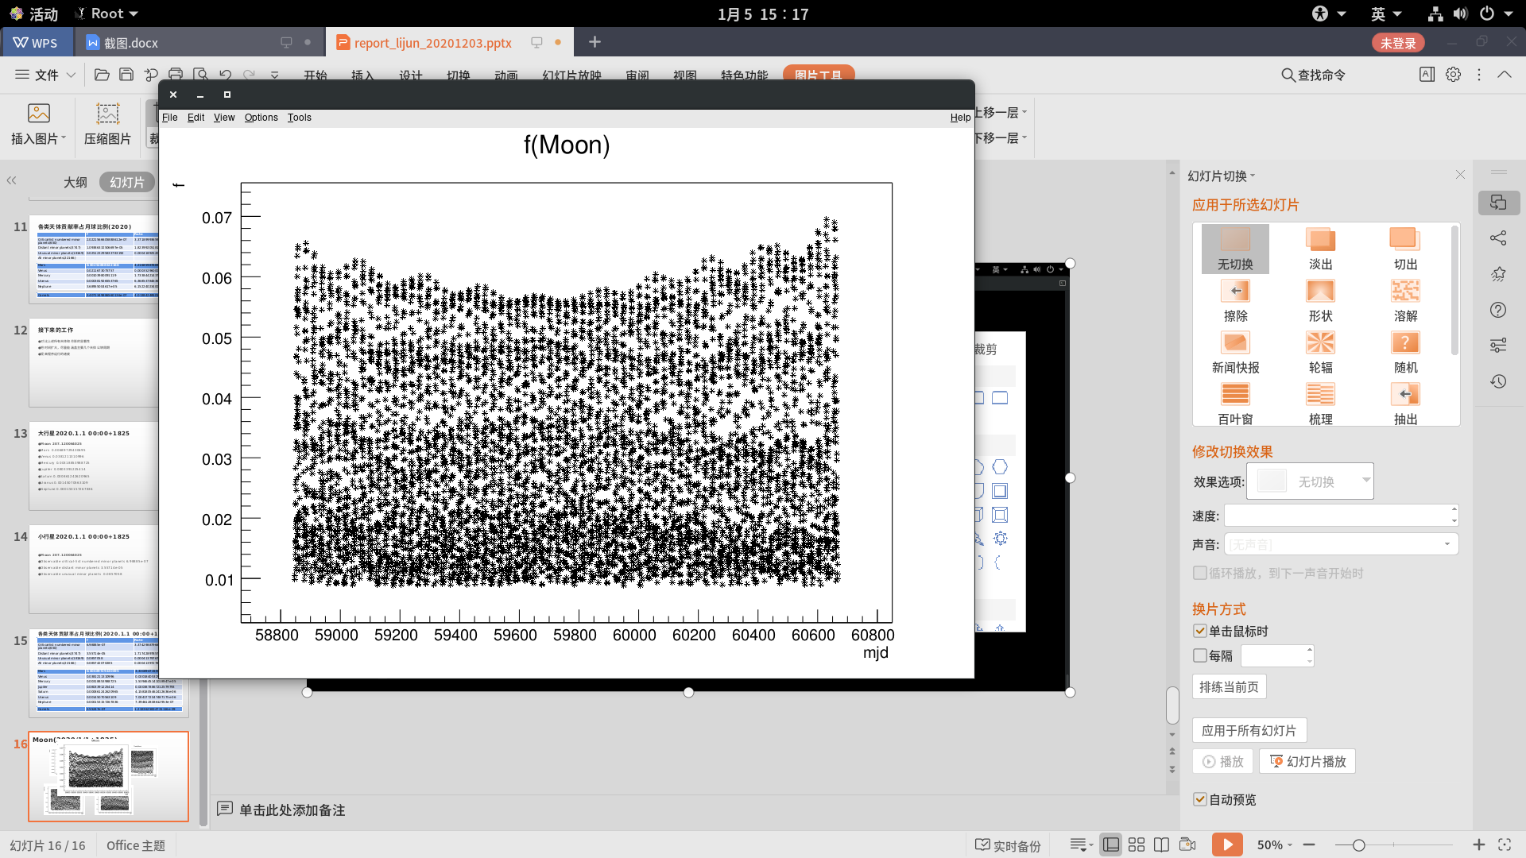
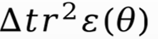
Moon(2020/1/1+1825)

Slide 12
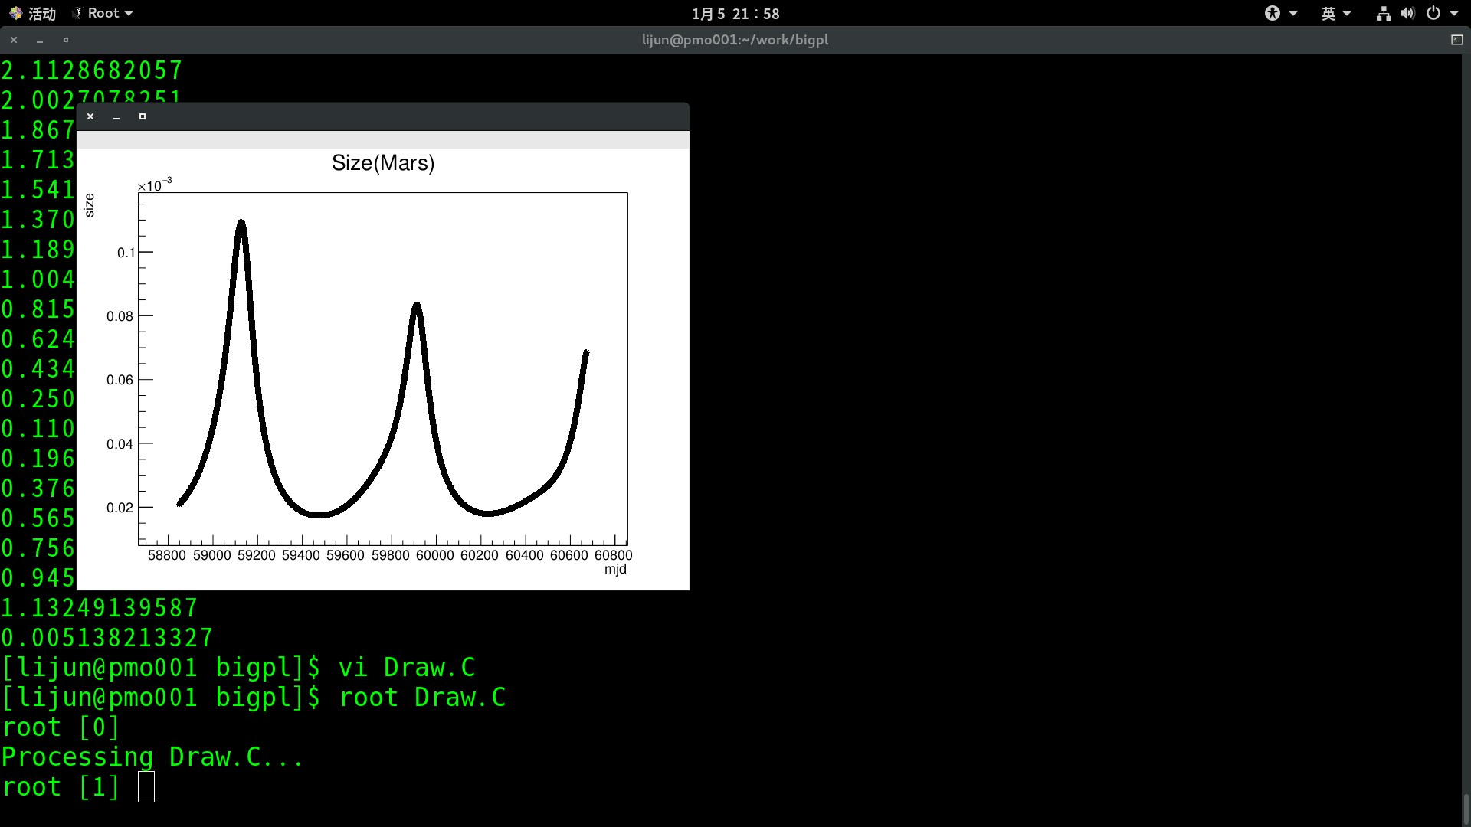
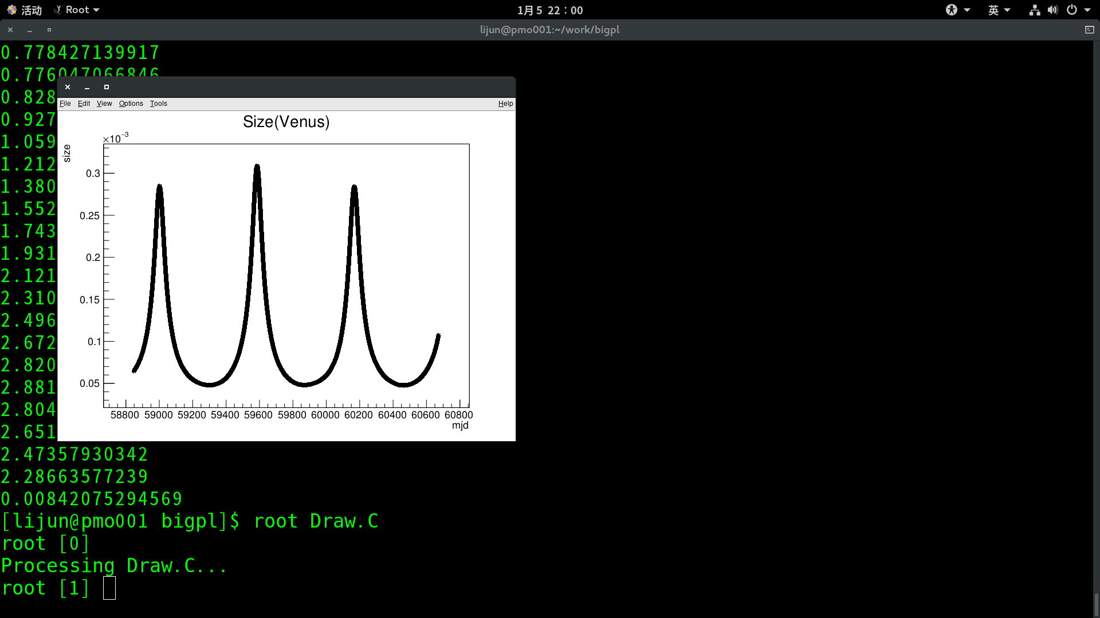
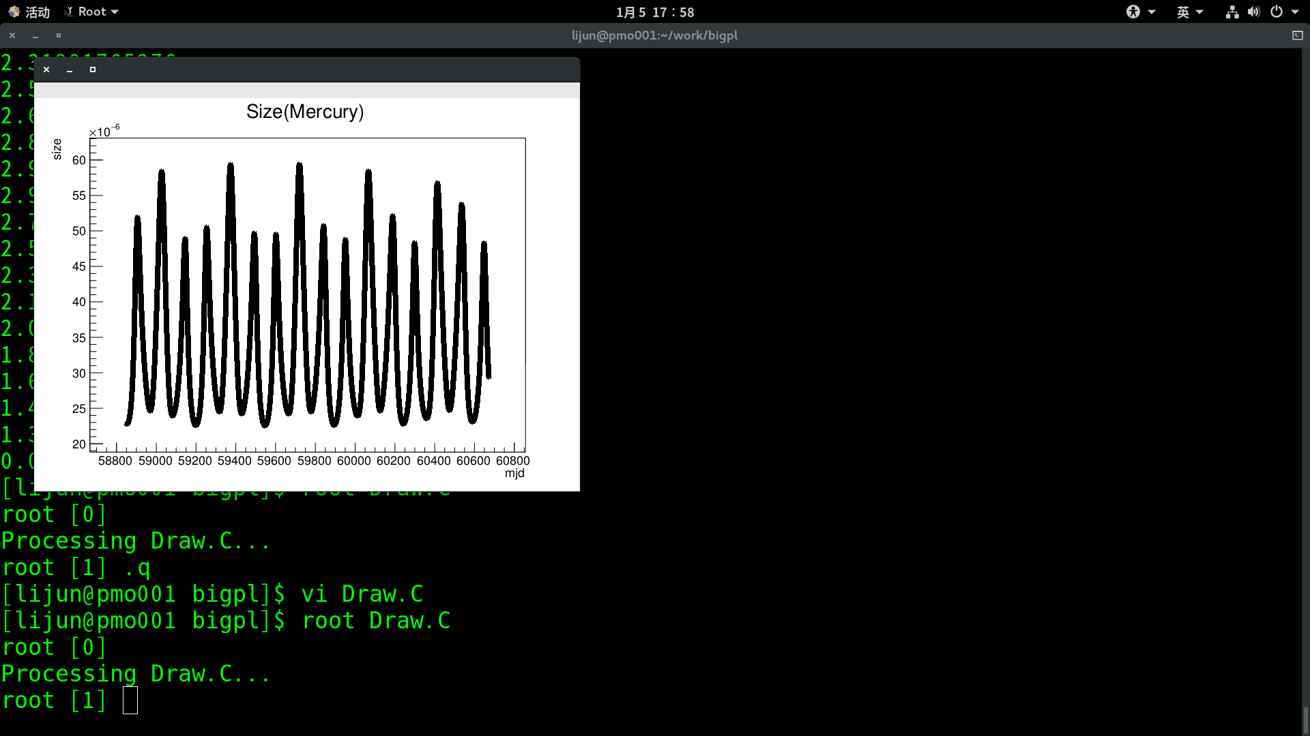
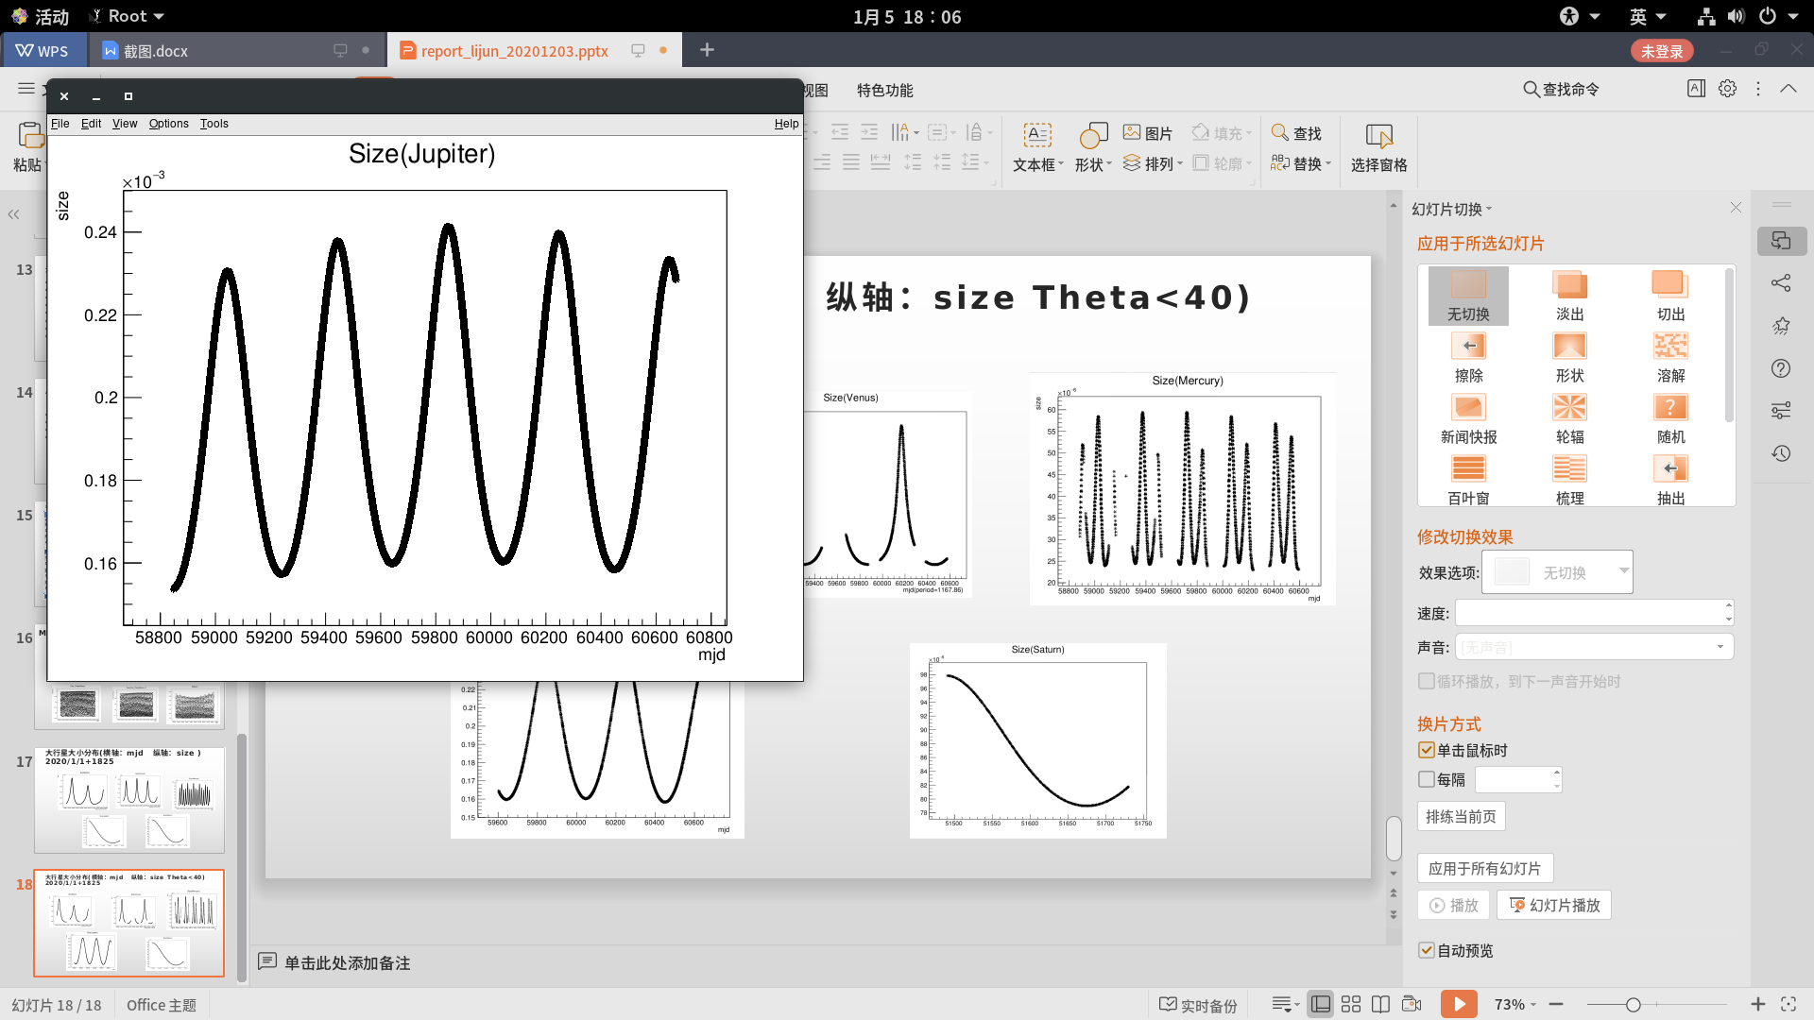
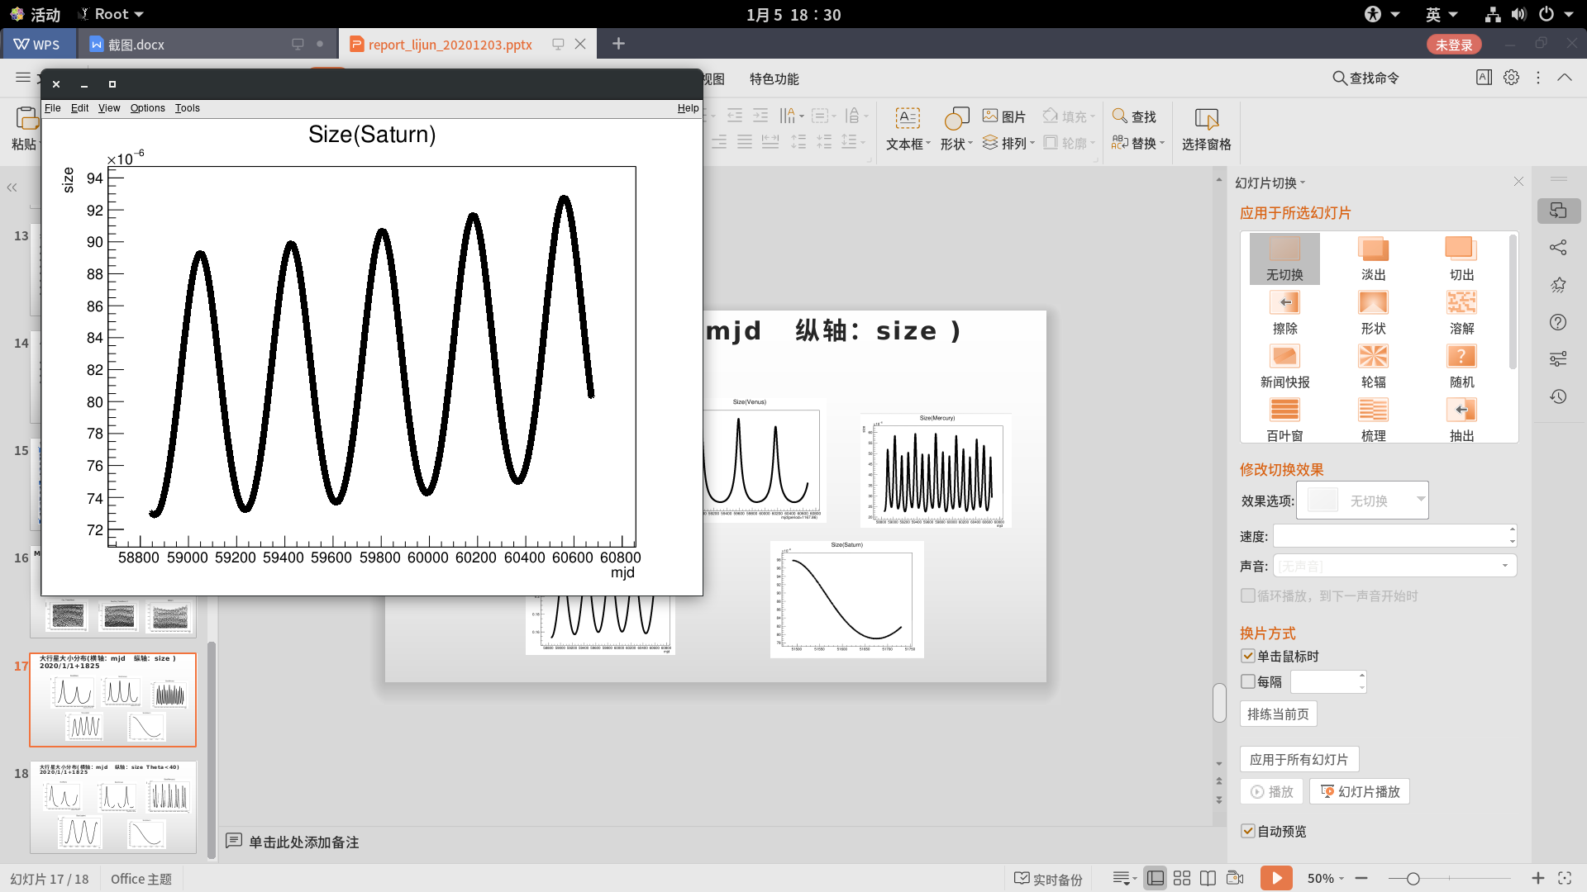
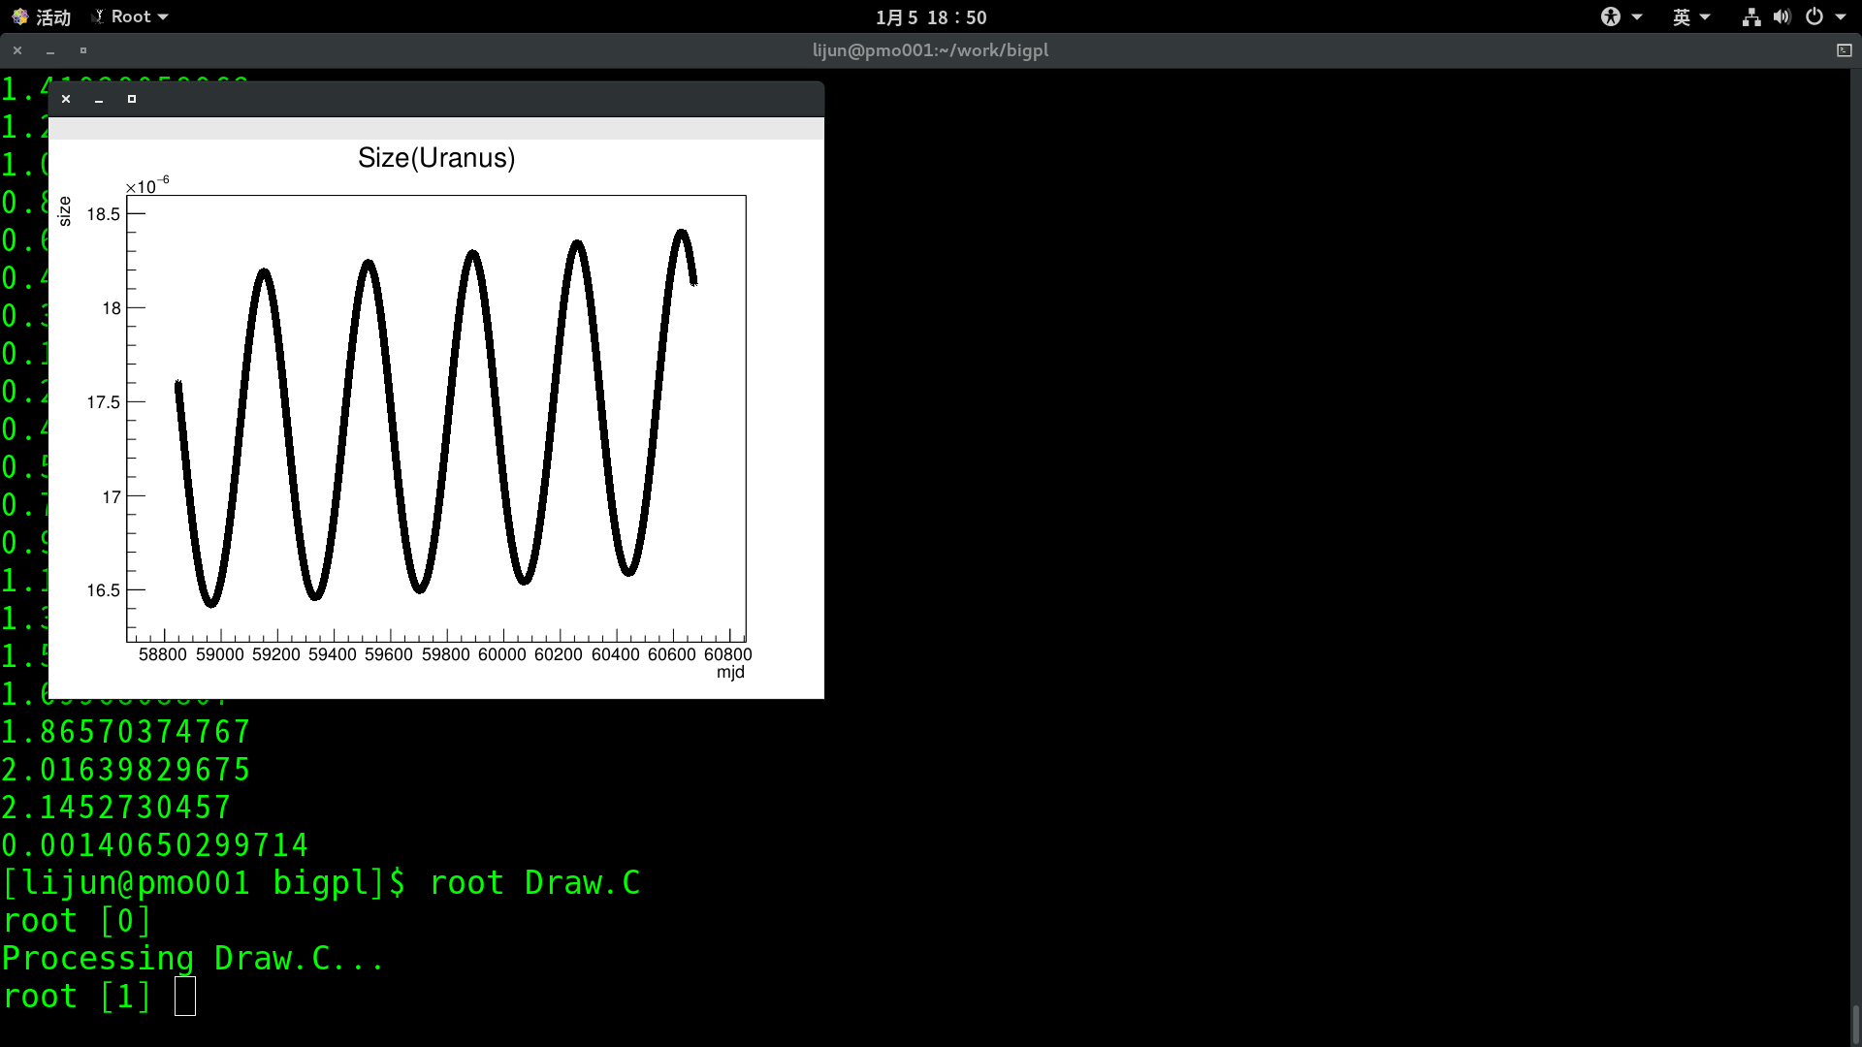
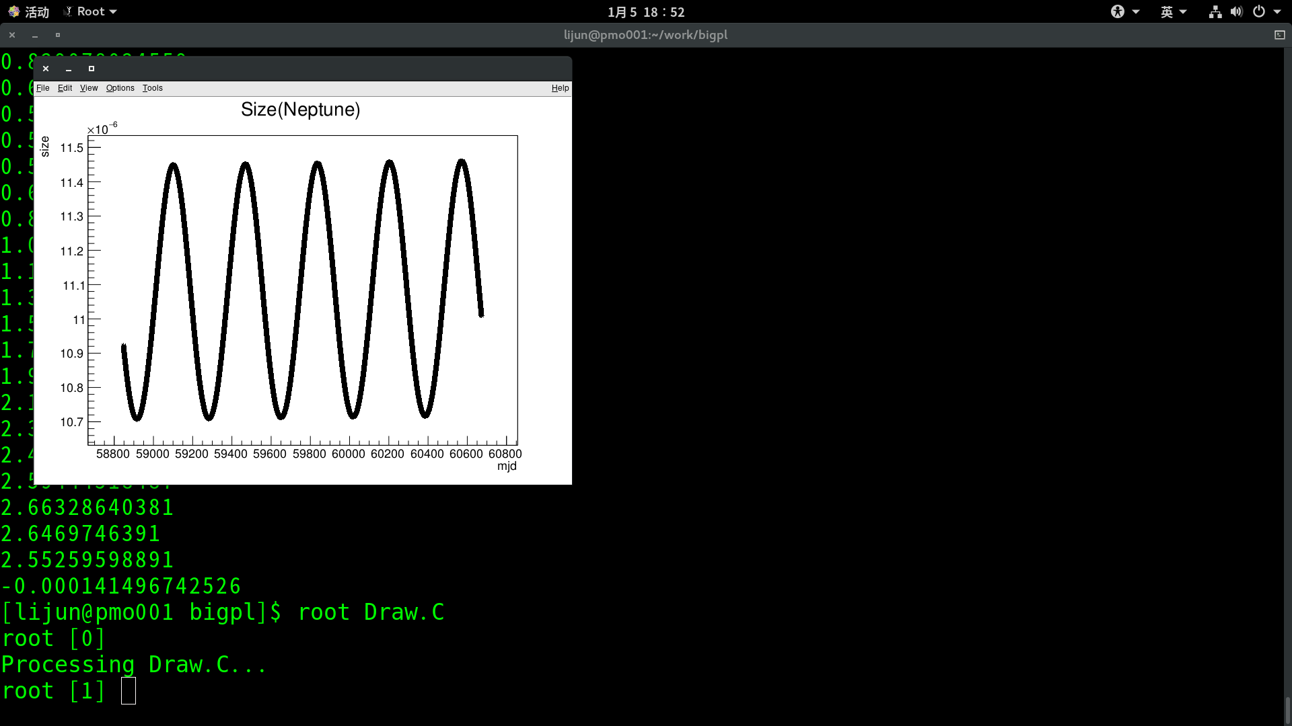
大行星大小分布(横轴：mjd 纵轴：size ) 2020/1/1+1825

Slide 13
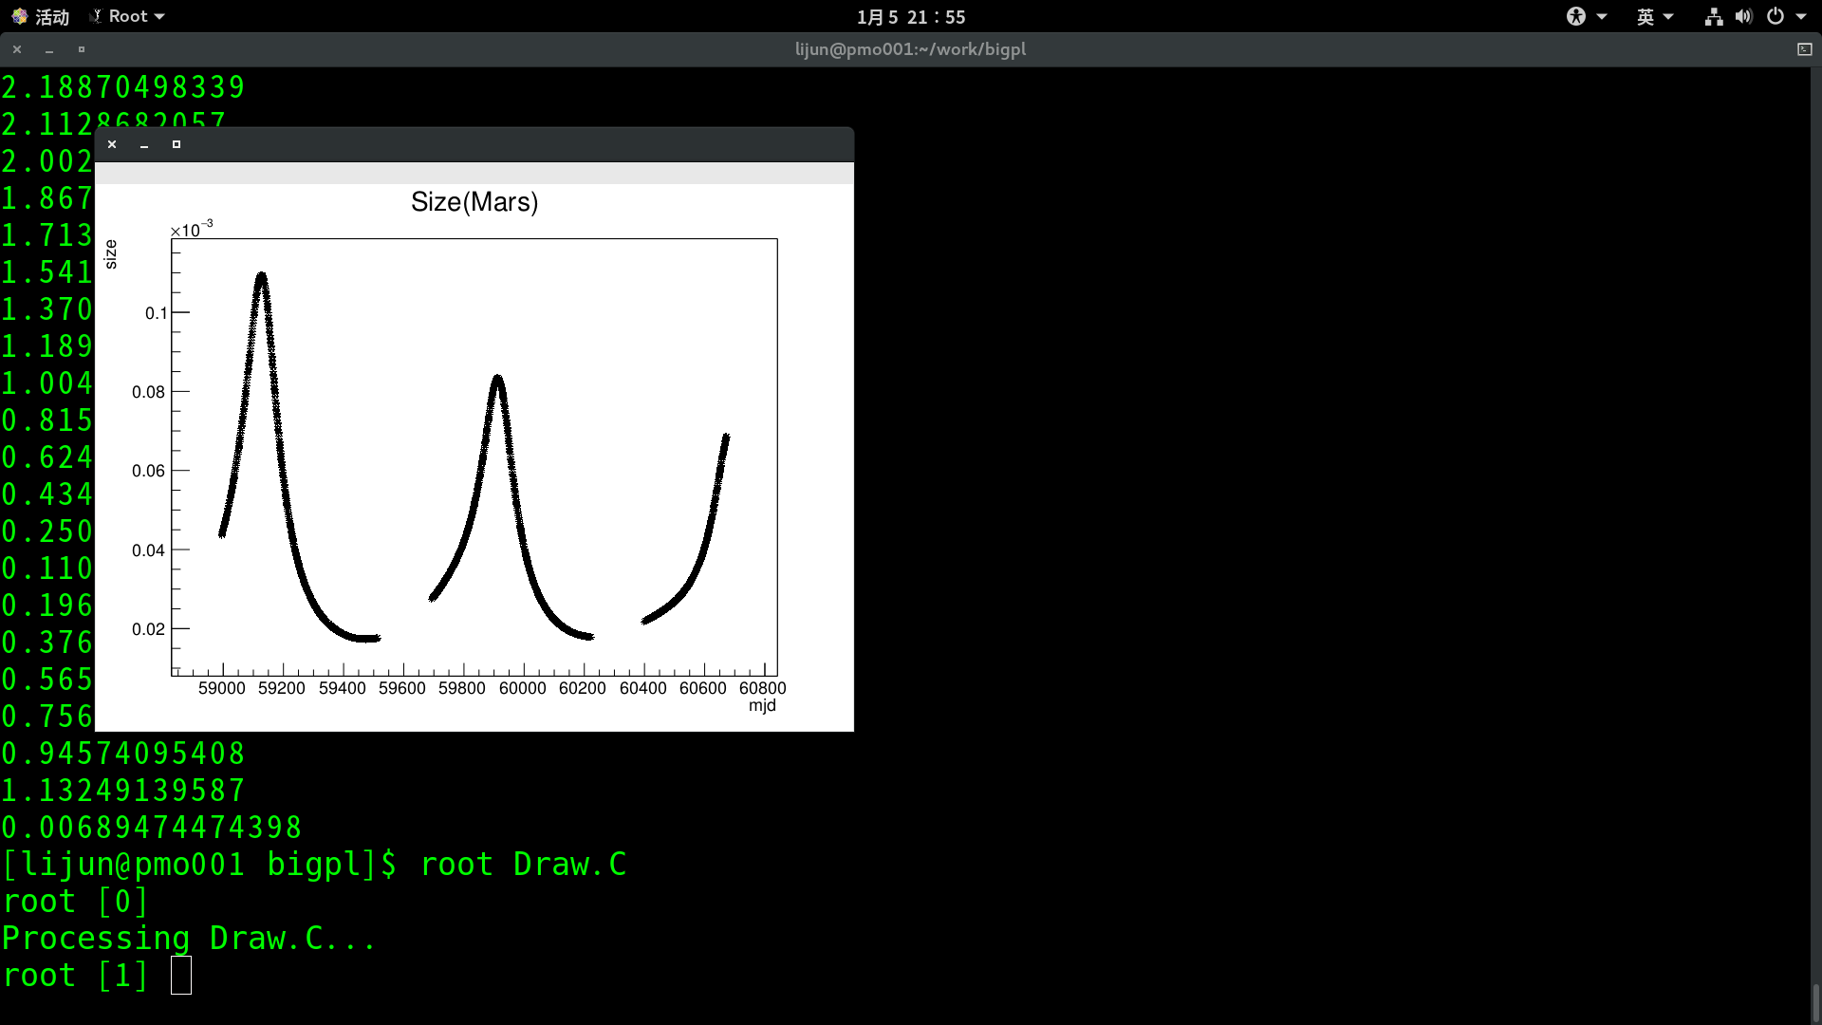
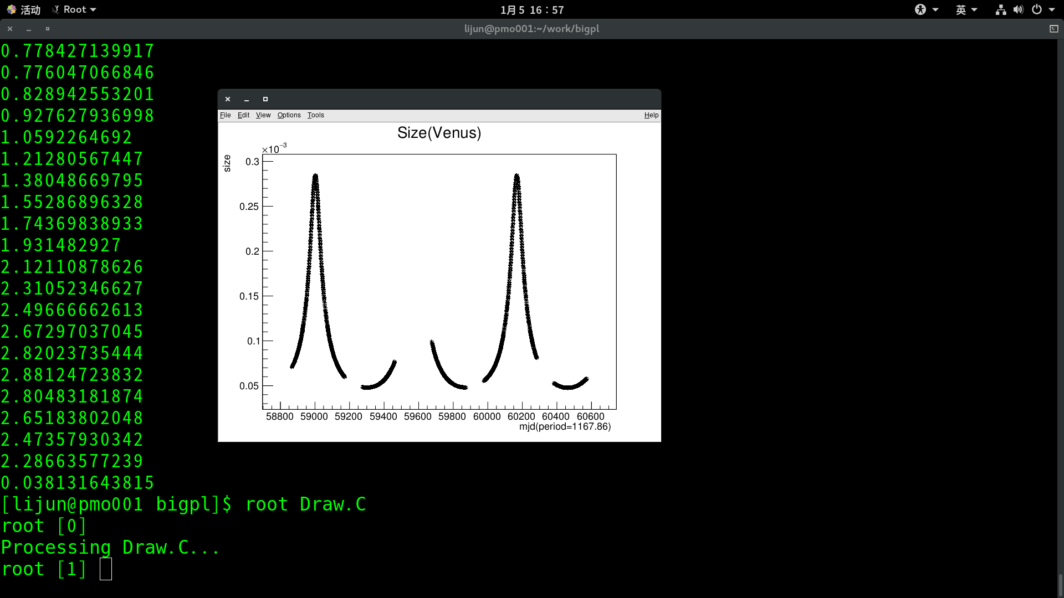
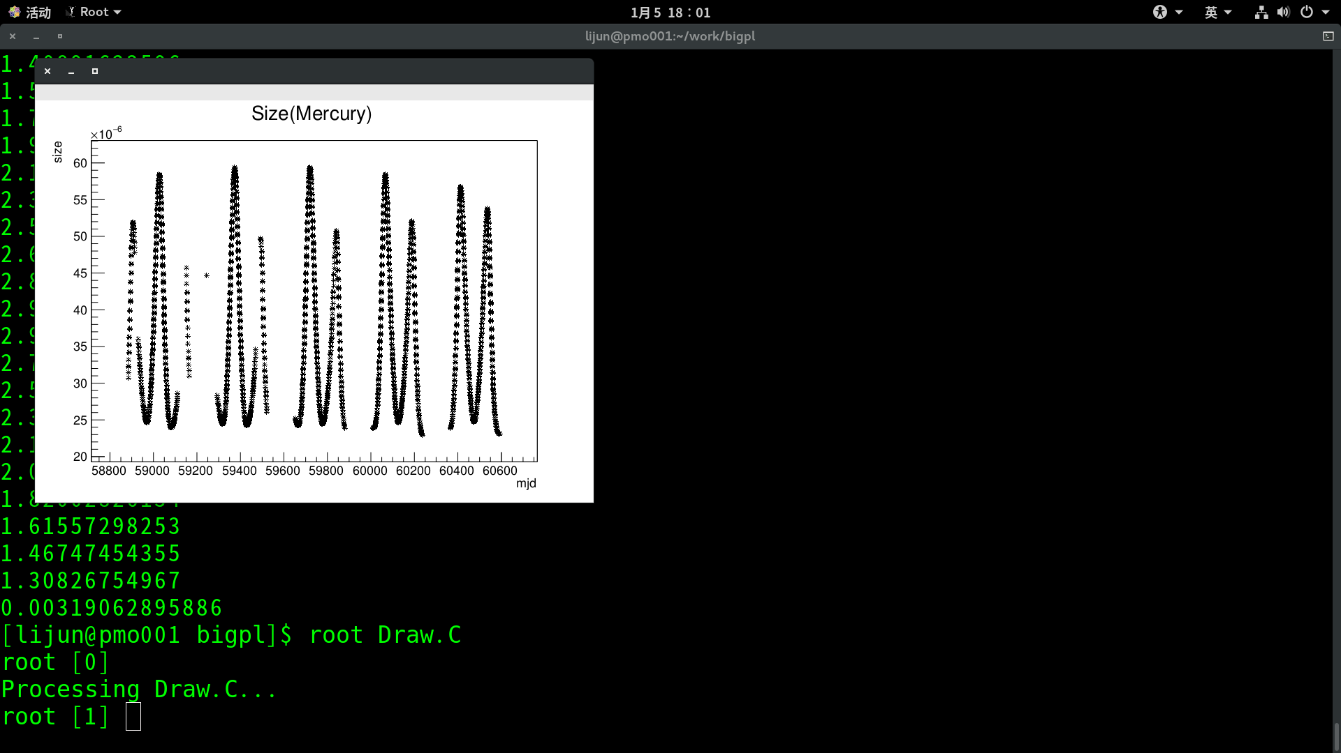
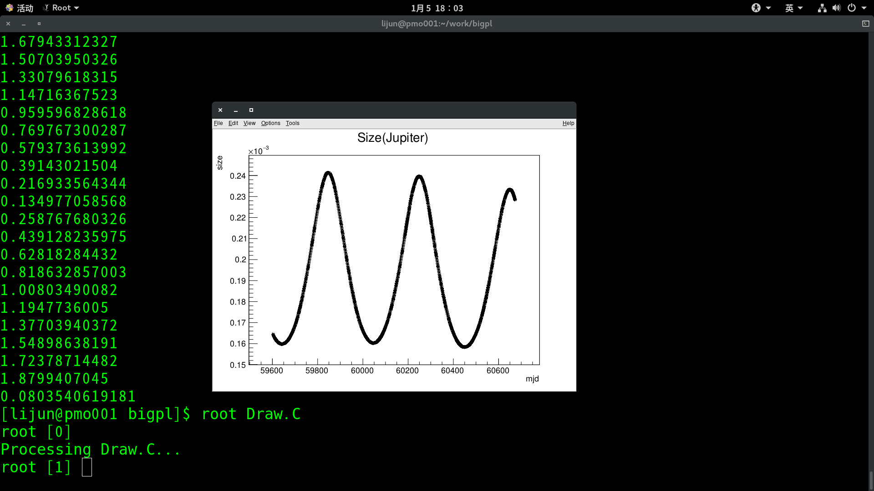
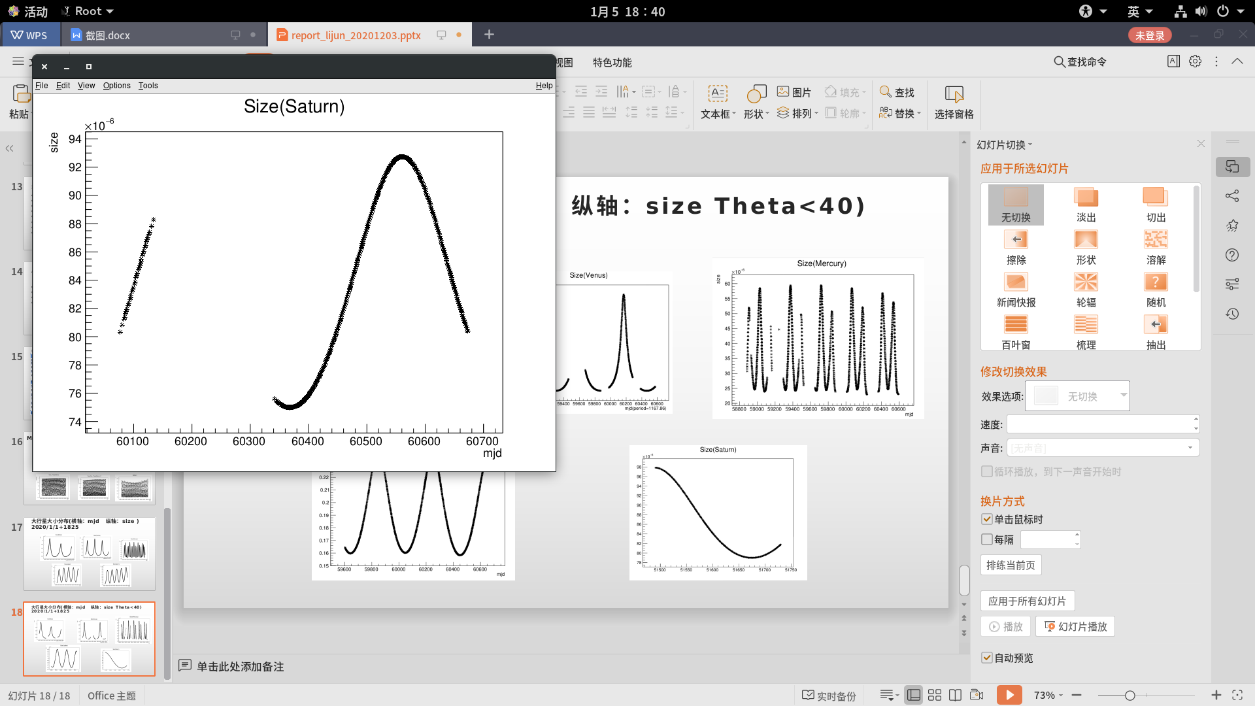
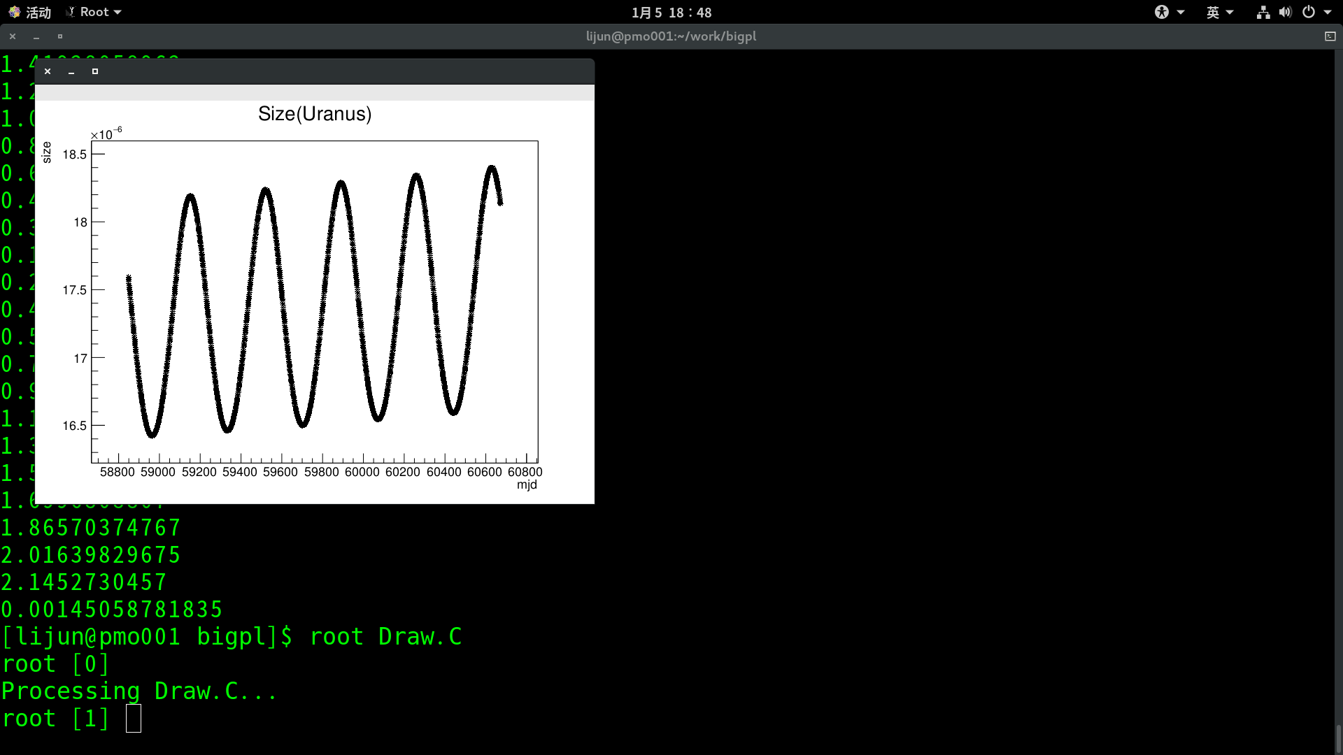

大行星大小分布(横轴：mjd 纵轴：size Theta<40) 2020/1/1+1825

Slide 14
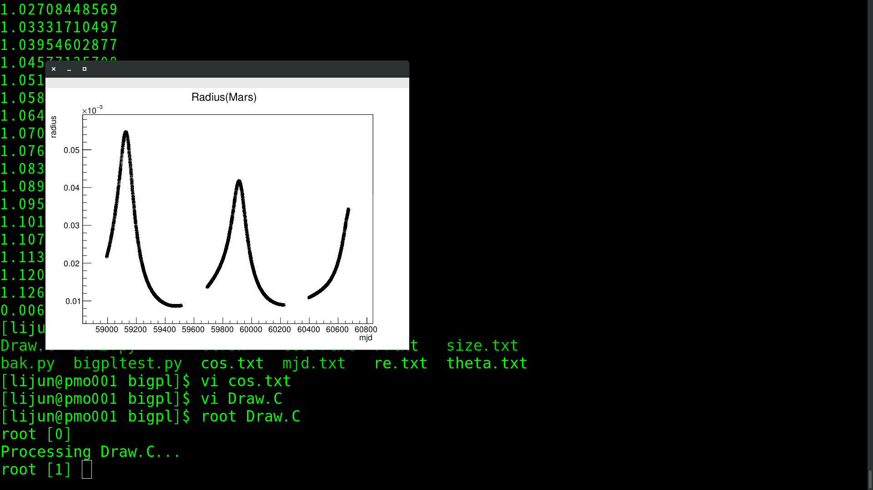
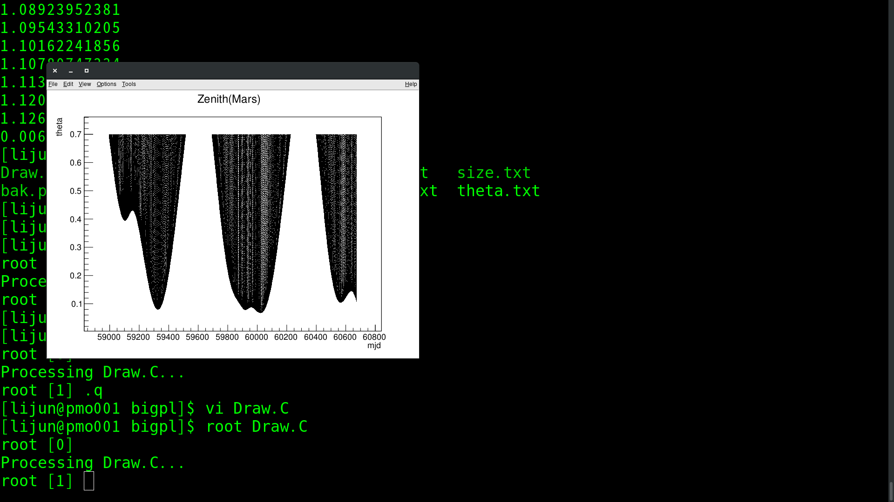
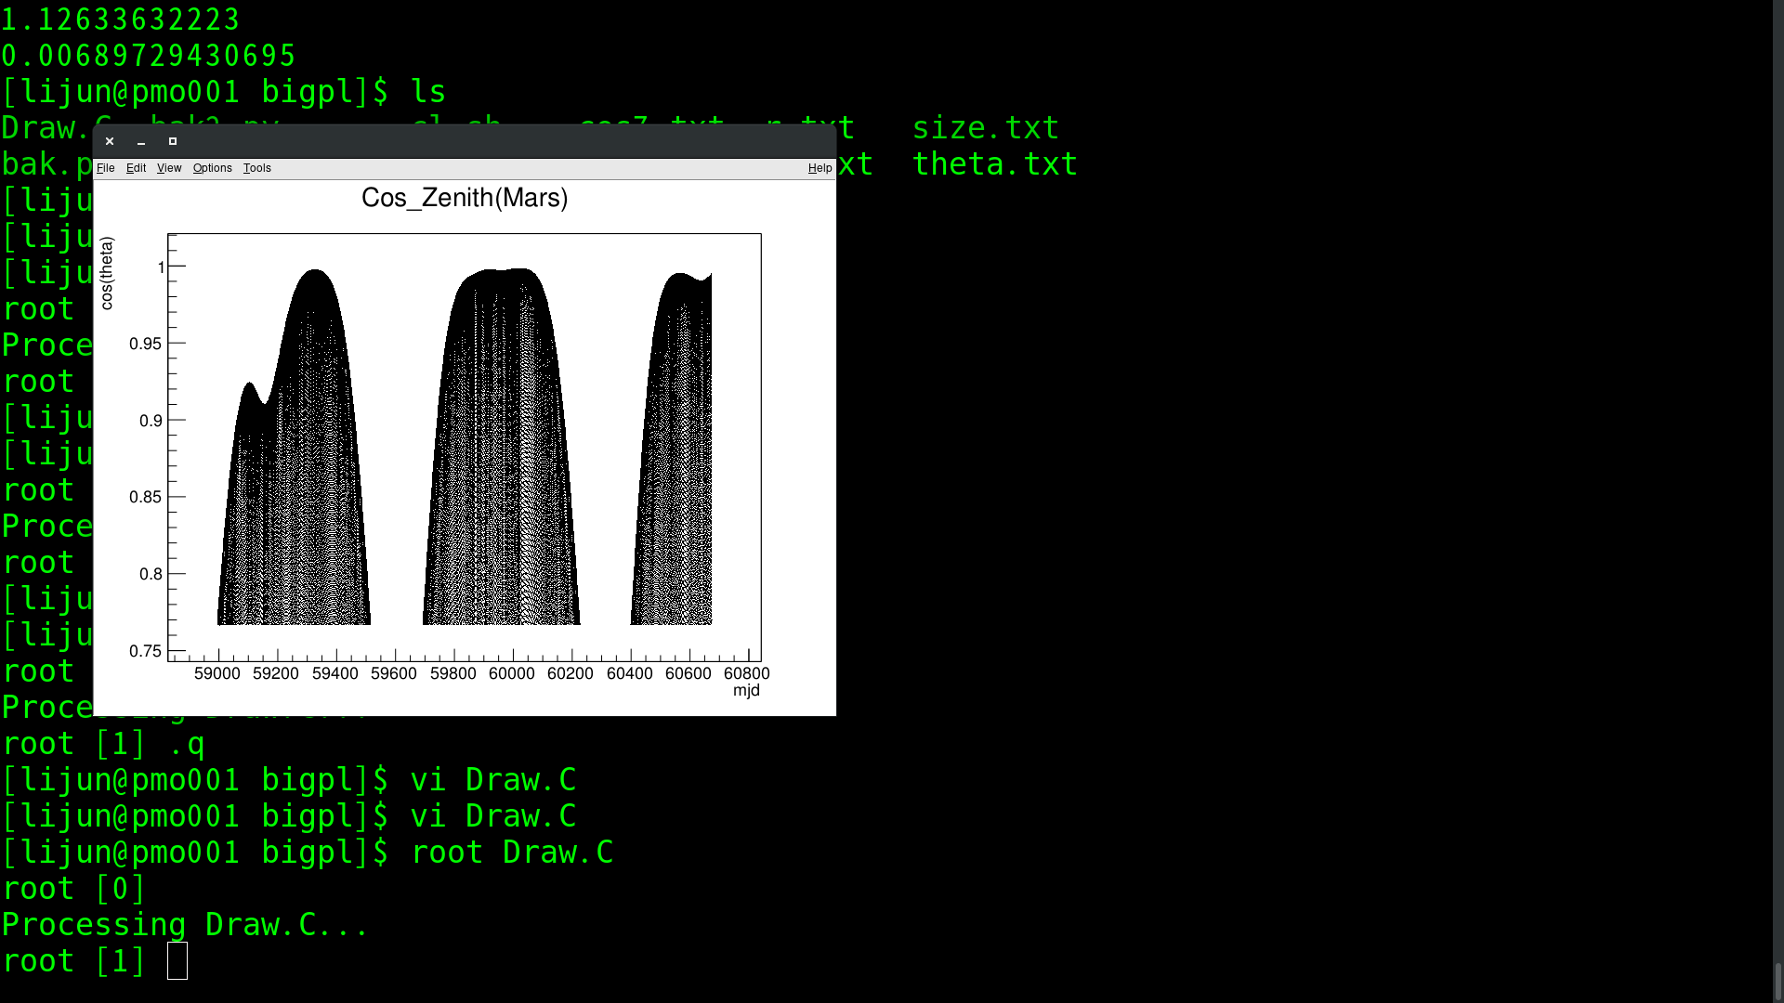
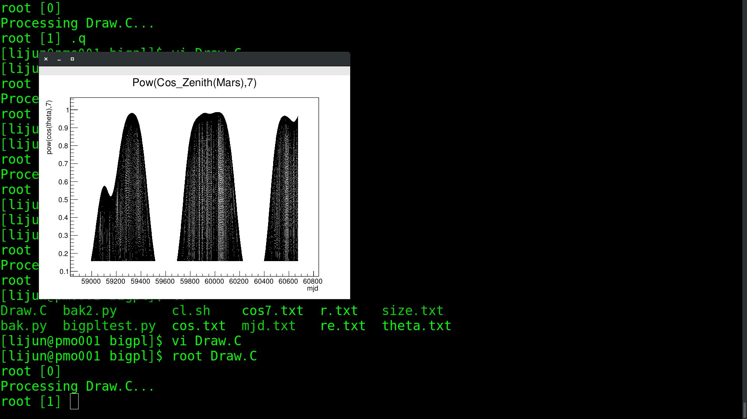
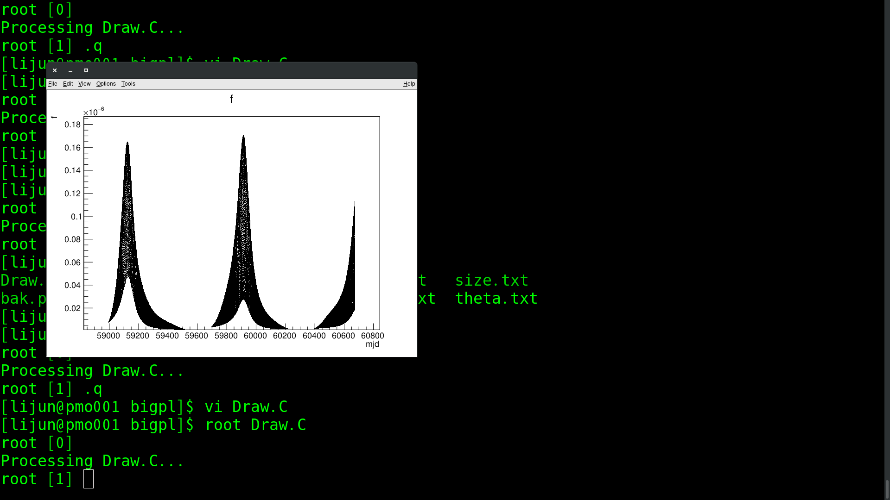
Mars

Slide 15
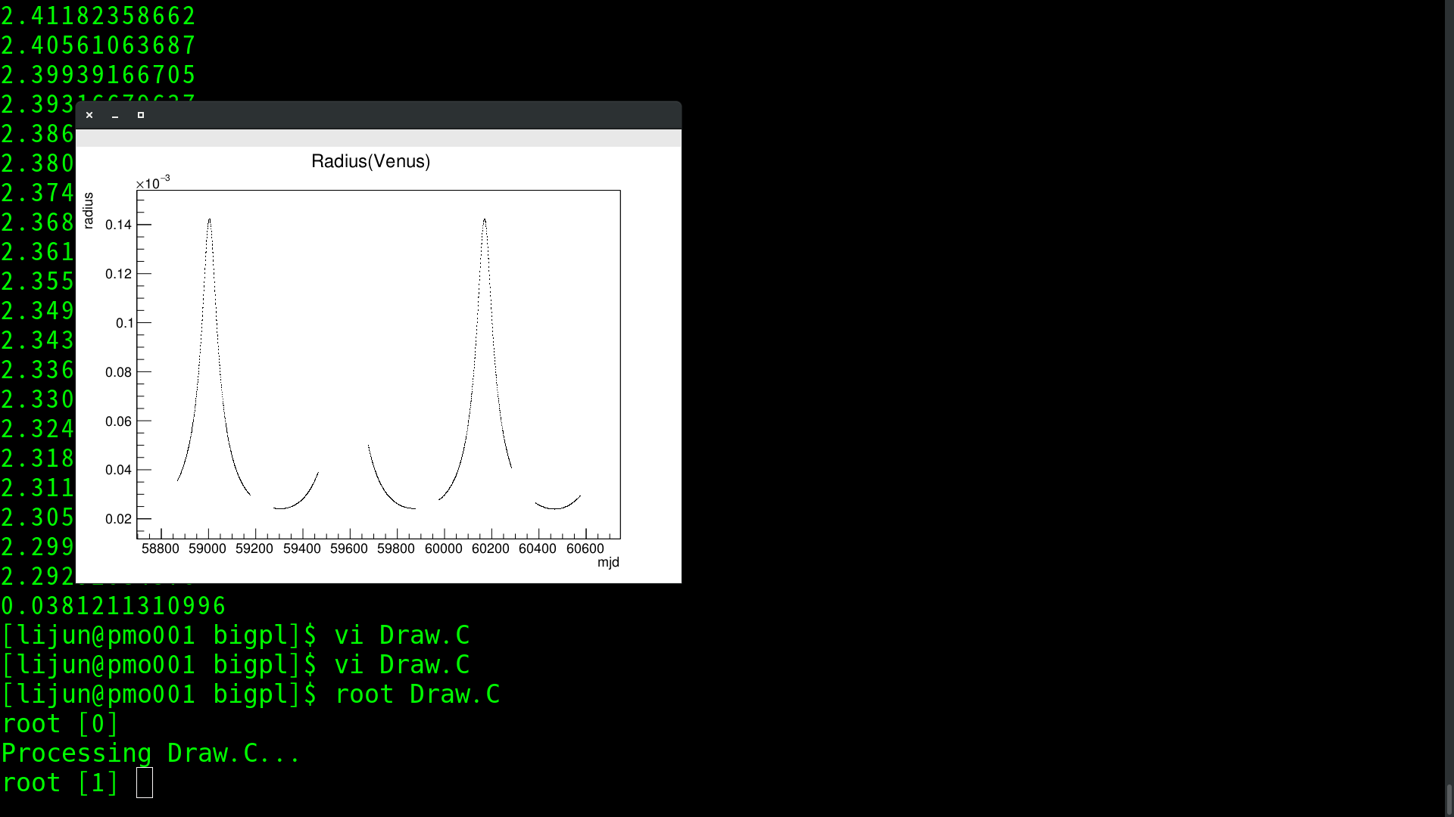
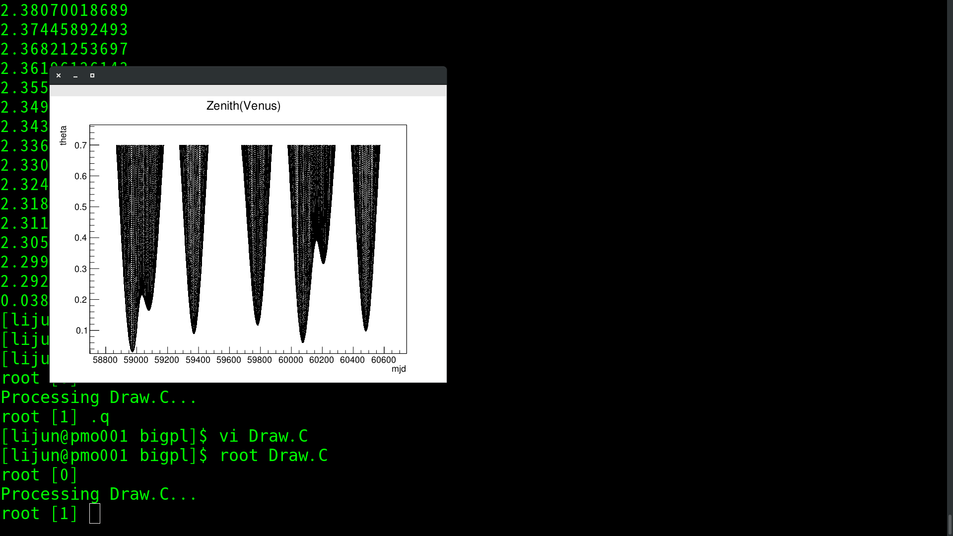
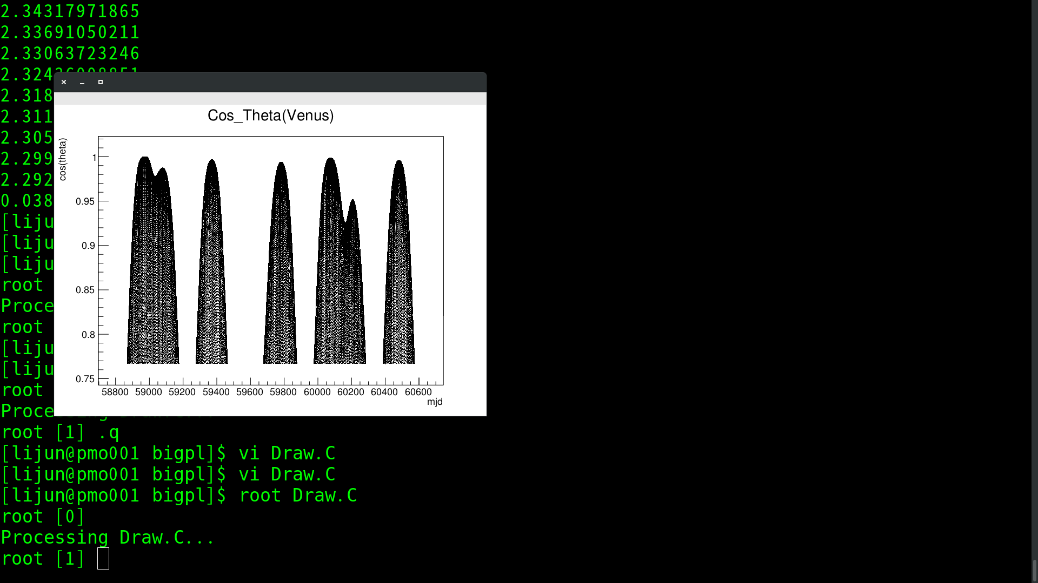
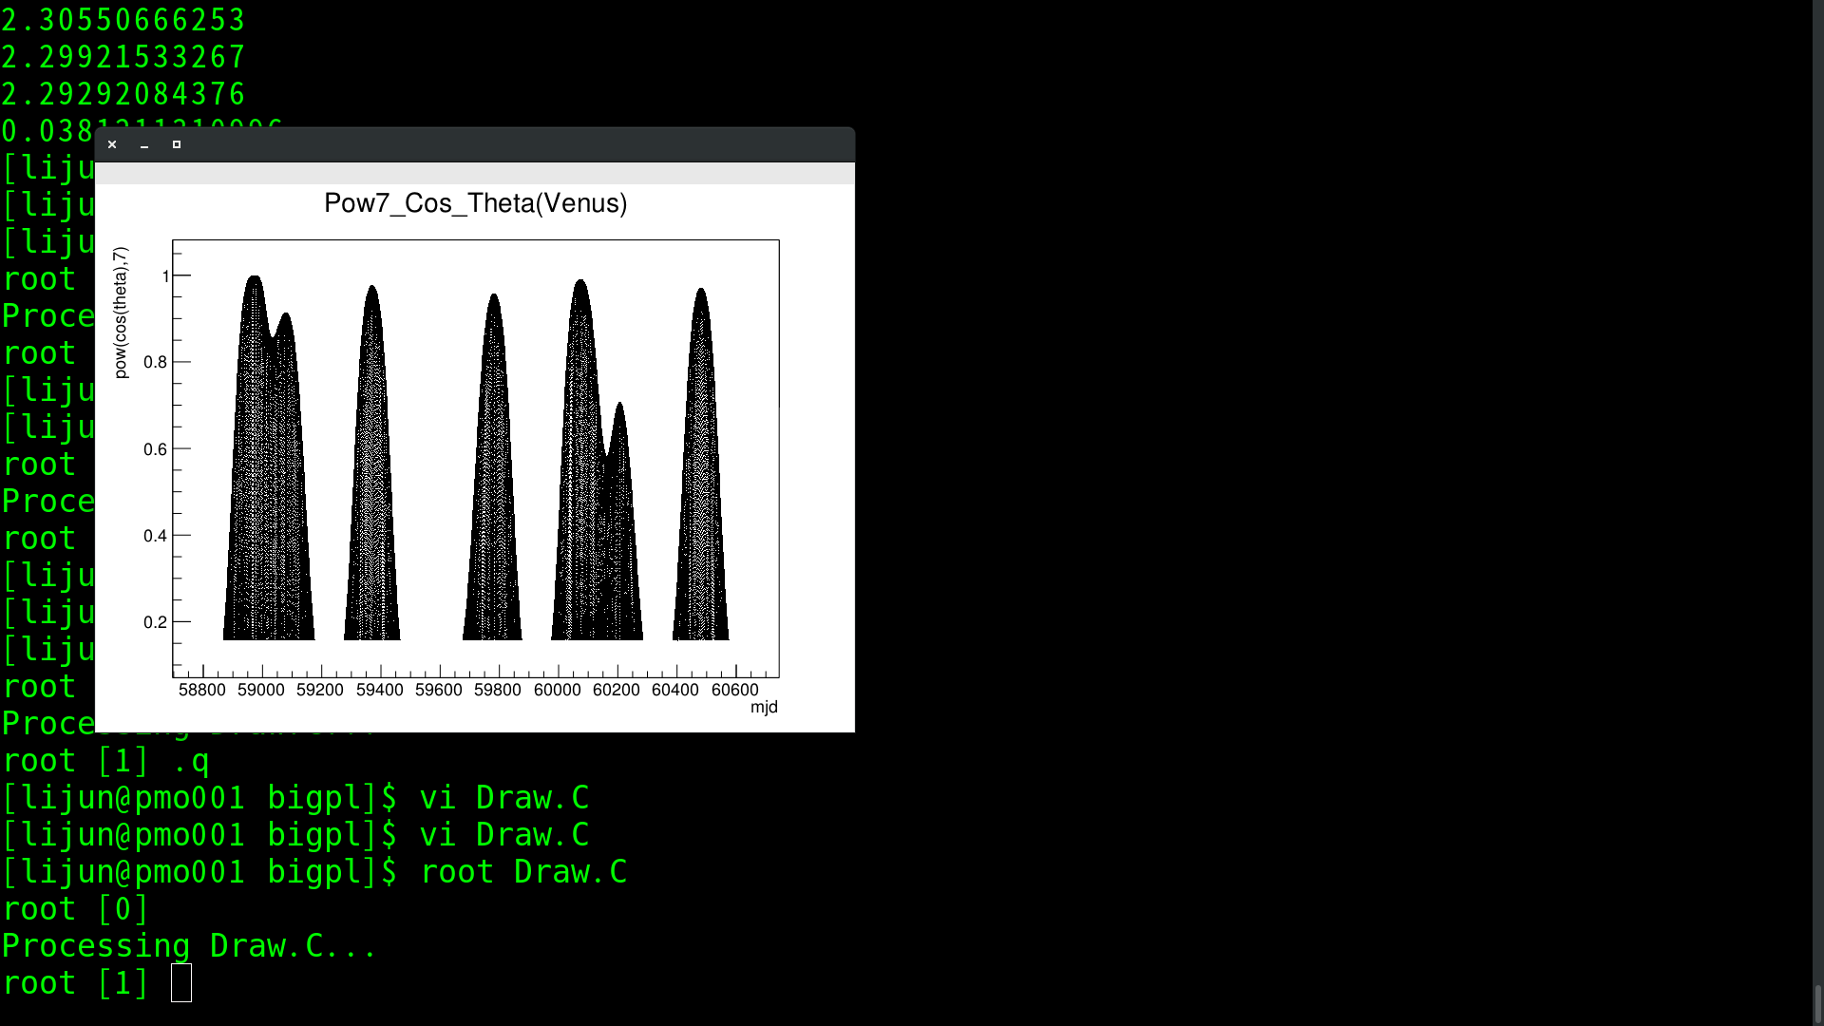
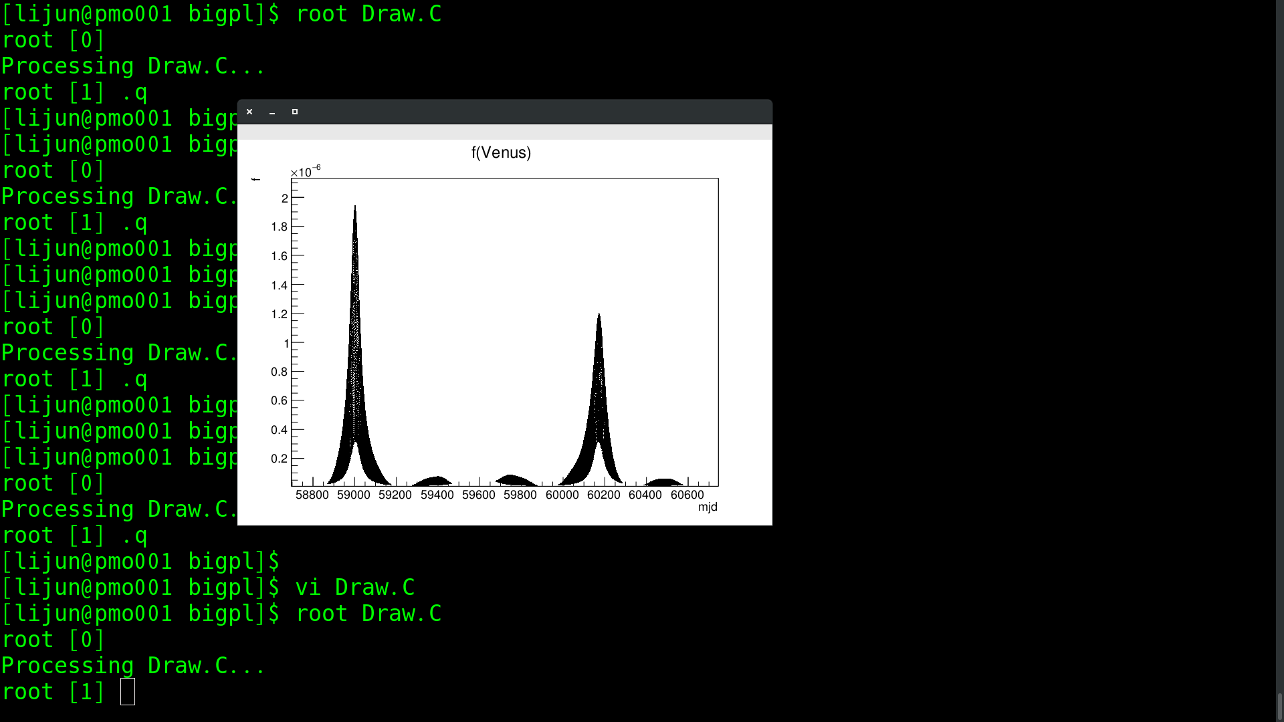
Venus

Slide 16
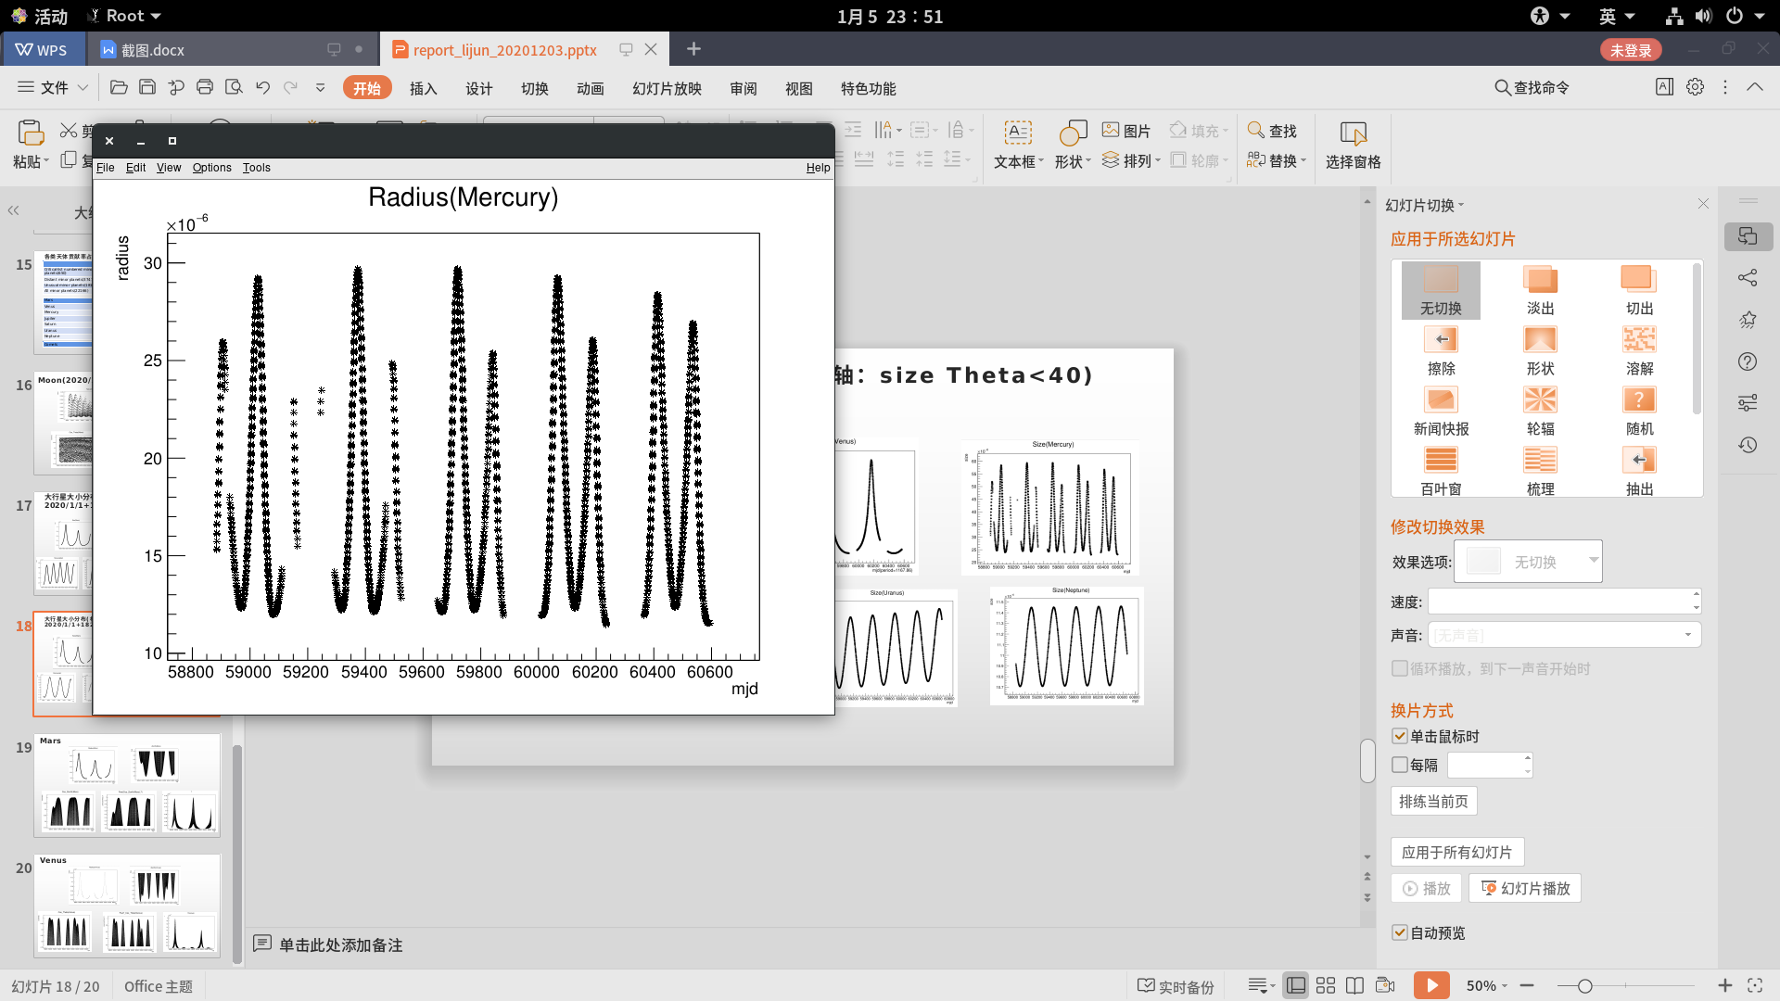
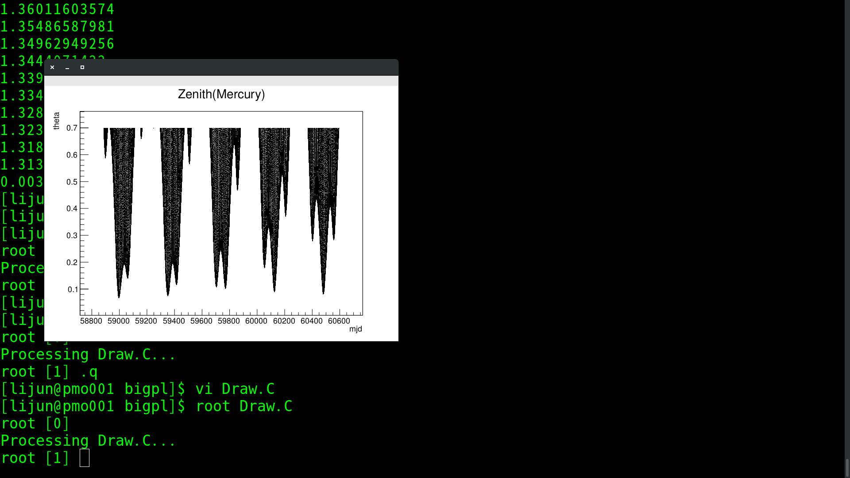
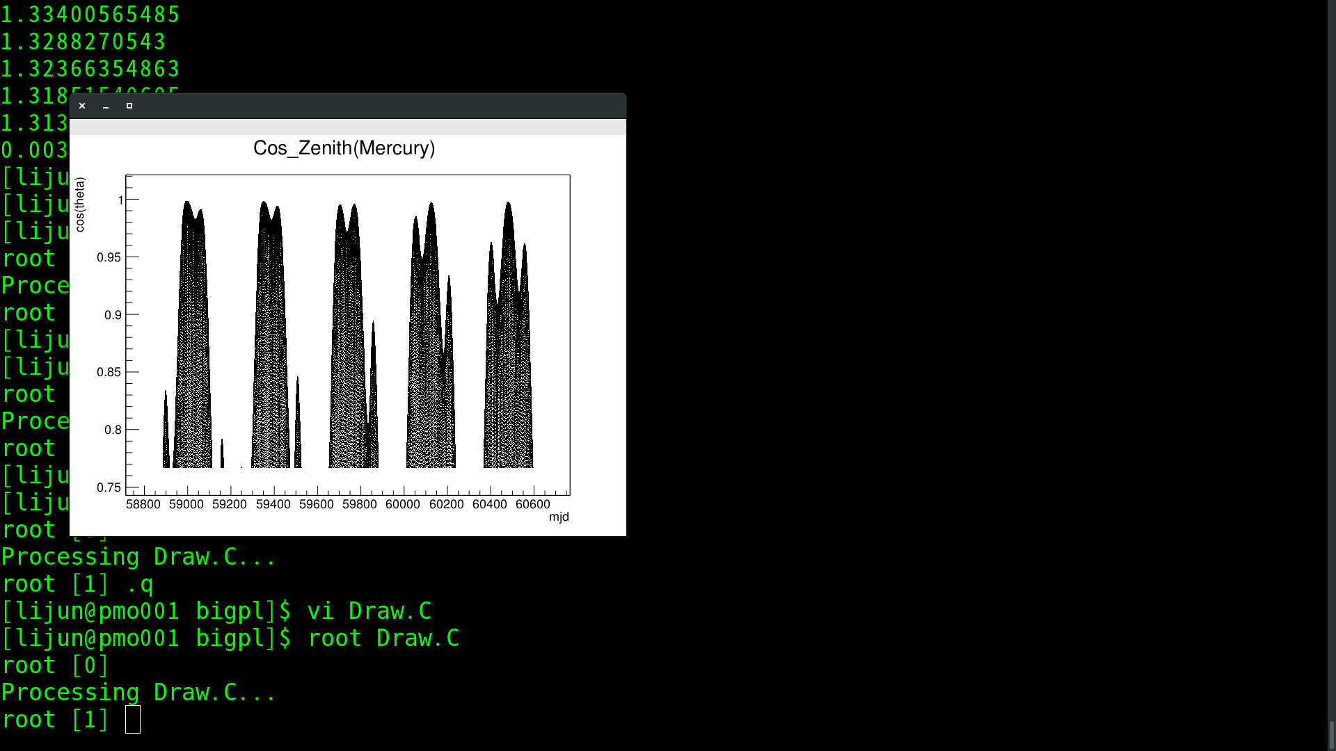
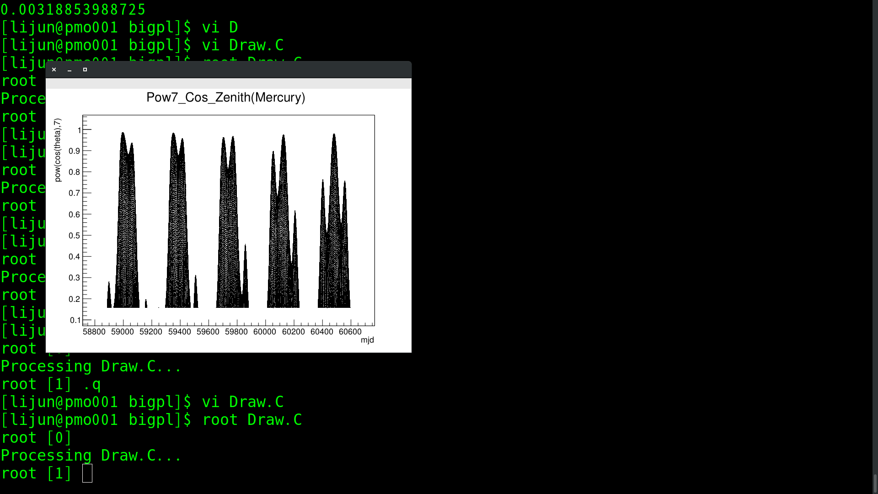
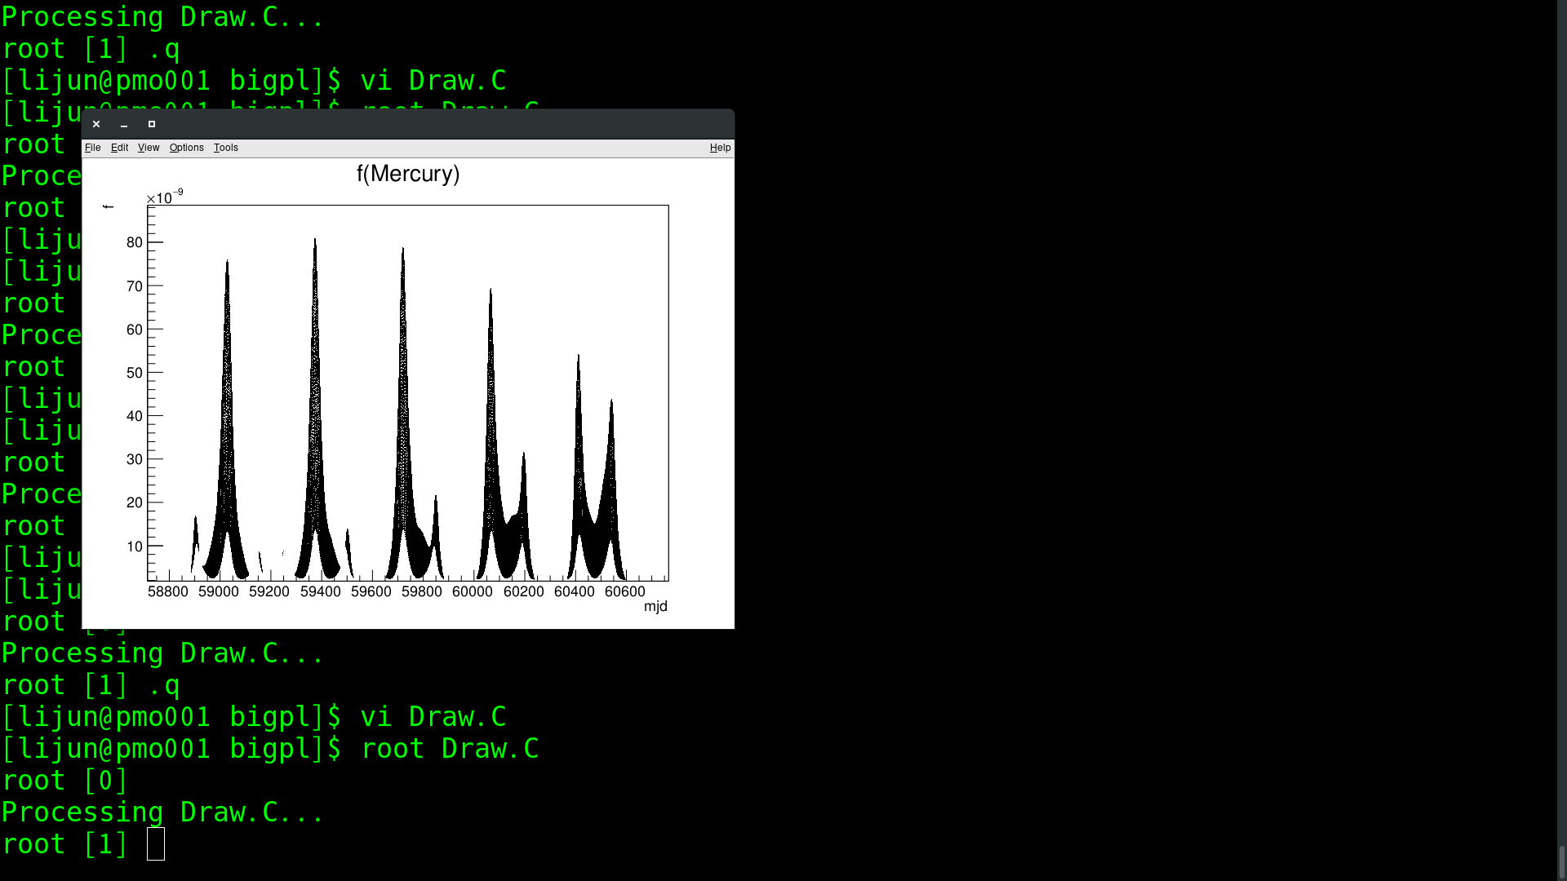
Mercury

Slide 17
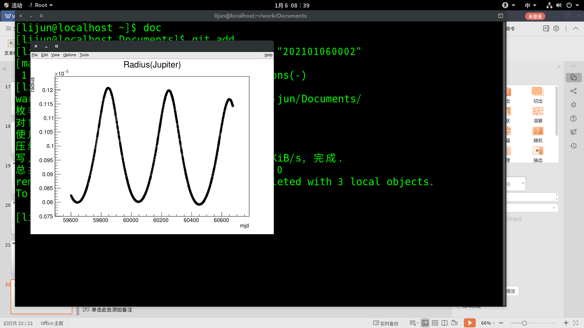
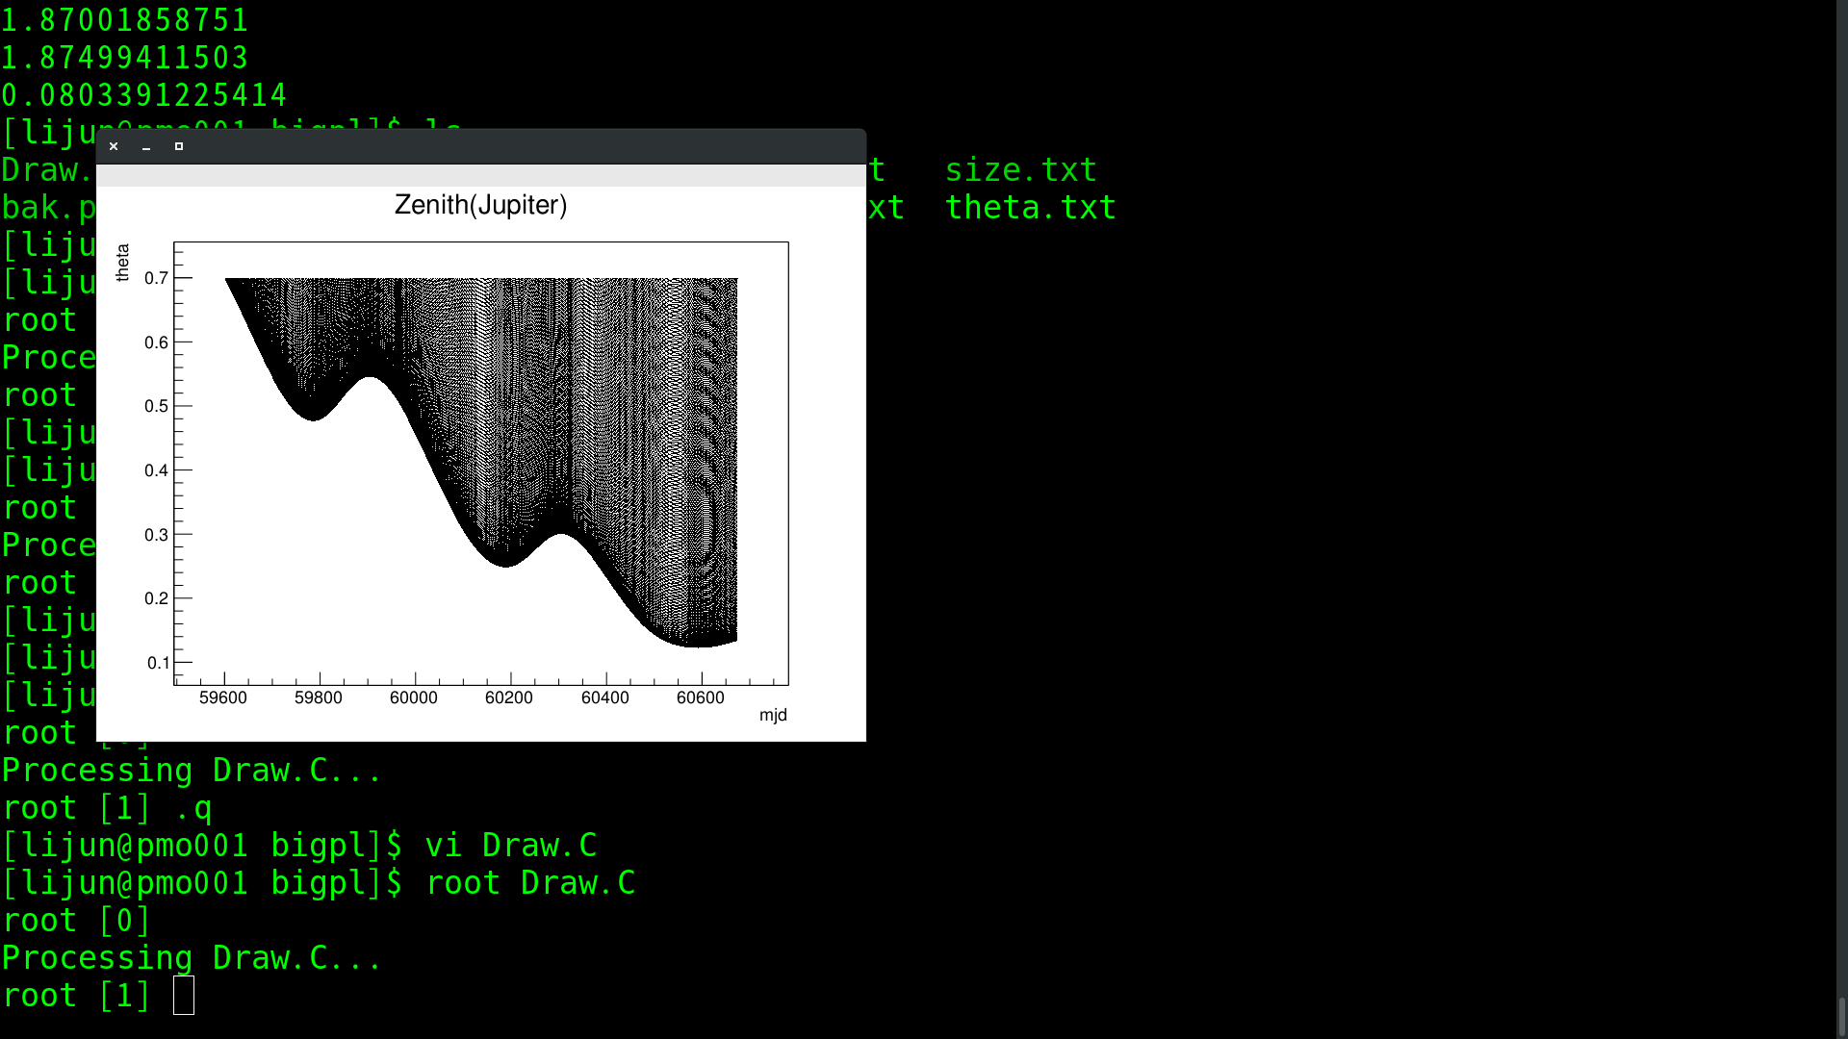



Jupiter

Slide 18





Saturn

Slide 19





Uranus

Slide 20





Neptune

Slide 21



Size distributions of minor planets 2020/01/01 00:00 +1825
quantity
size
Distant minor planets
quantity
quantity
size
Critical-list numbered minor planets
size
Unusual minor planets

Slide 22
各类天体贡献率占月球比例(2020.1.1 00:00+1825)
 | f | Rate
Critical-list numbered minor planets(650) | 6.98885e-07 | 3.374298879685758e-09
Distant minor planets(3747) | 3.55714e-05 | 1.7174289785709234e-07
Unusual minor planets(18169) | 0.0857058 | 0.0004137976704644851
All minor planets(22166) | 0.085742070285 | 0.00041397278766122186
Mars | 0.00689729430695 | 3.330094715554683e-05
Venus | 0.0381211310996 | 0.00018405329912894708
Mercury | 0.00318853988725 | 1.5394645141018947e-05
Jupiter | 0.0803391225414 | 0.0003878867212579793
Saturn | 0.000861242620965 | 4.1581805462412636e-06
Uranus | 0.00145070563109 | 7.0041772047487175e-06
Neptune | 0.000153157267836 | 7.394612808612953e-07
Comets | 2.55247e-07 | 1.2323625004731116e-09

